Slide 1
Introduction to R
Audrey Webb & Charles Li
University of California, Berkeley
July 24, 2018
Sichuan Center for Disease Control and Prevention
Institute of Public Health Informatics

Slide 2
Agenda
Overview & Setup
Data Types & Data Structures
Tools for Data Wrangling & Exploratory Data Analysis
Conducting Statistical Tests
Discussion, Feedback, & Further Resources

Slide 3
Overview & Setup
Data Types & Data Structures
Tools for Data Wrangling & Exploratory Data Analysis
Conducting Statistical Tests
Discussion, Feedback, & Further Resources

Slide 4



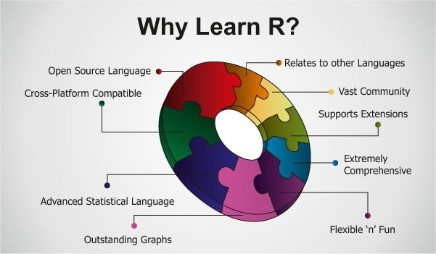
About R
a programming language for interactive data analysis developed in 1996
enables highly customizable analyses that are easy to share and replicate
employs a variety of free, open-source numerical and statistical tools for data analysis
https://www.r-project.org
Notes:
“interactive”: having dialogue with computer; you type commands, execute them, and get results (ask questions, get answers)

Slide 5
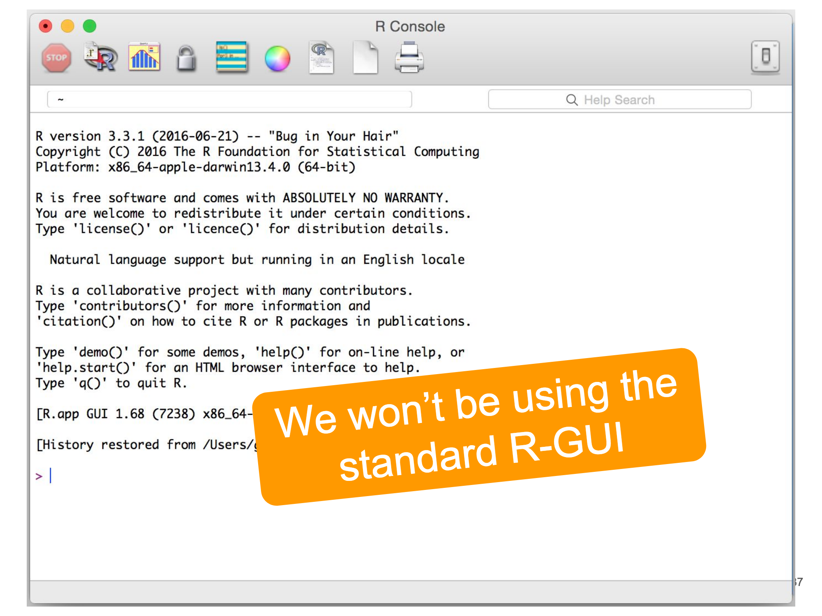

Using R
while R comes with its own graphical user interface (GUI), we will be using a more advanced interface called RStudio
in addition to providing a more sophisticated working environment, RStudio enables the creation of R Markdown files (.rmd) that combine narrative text and code into a single document

Slide 6
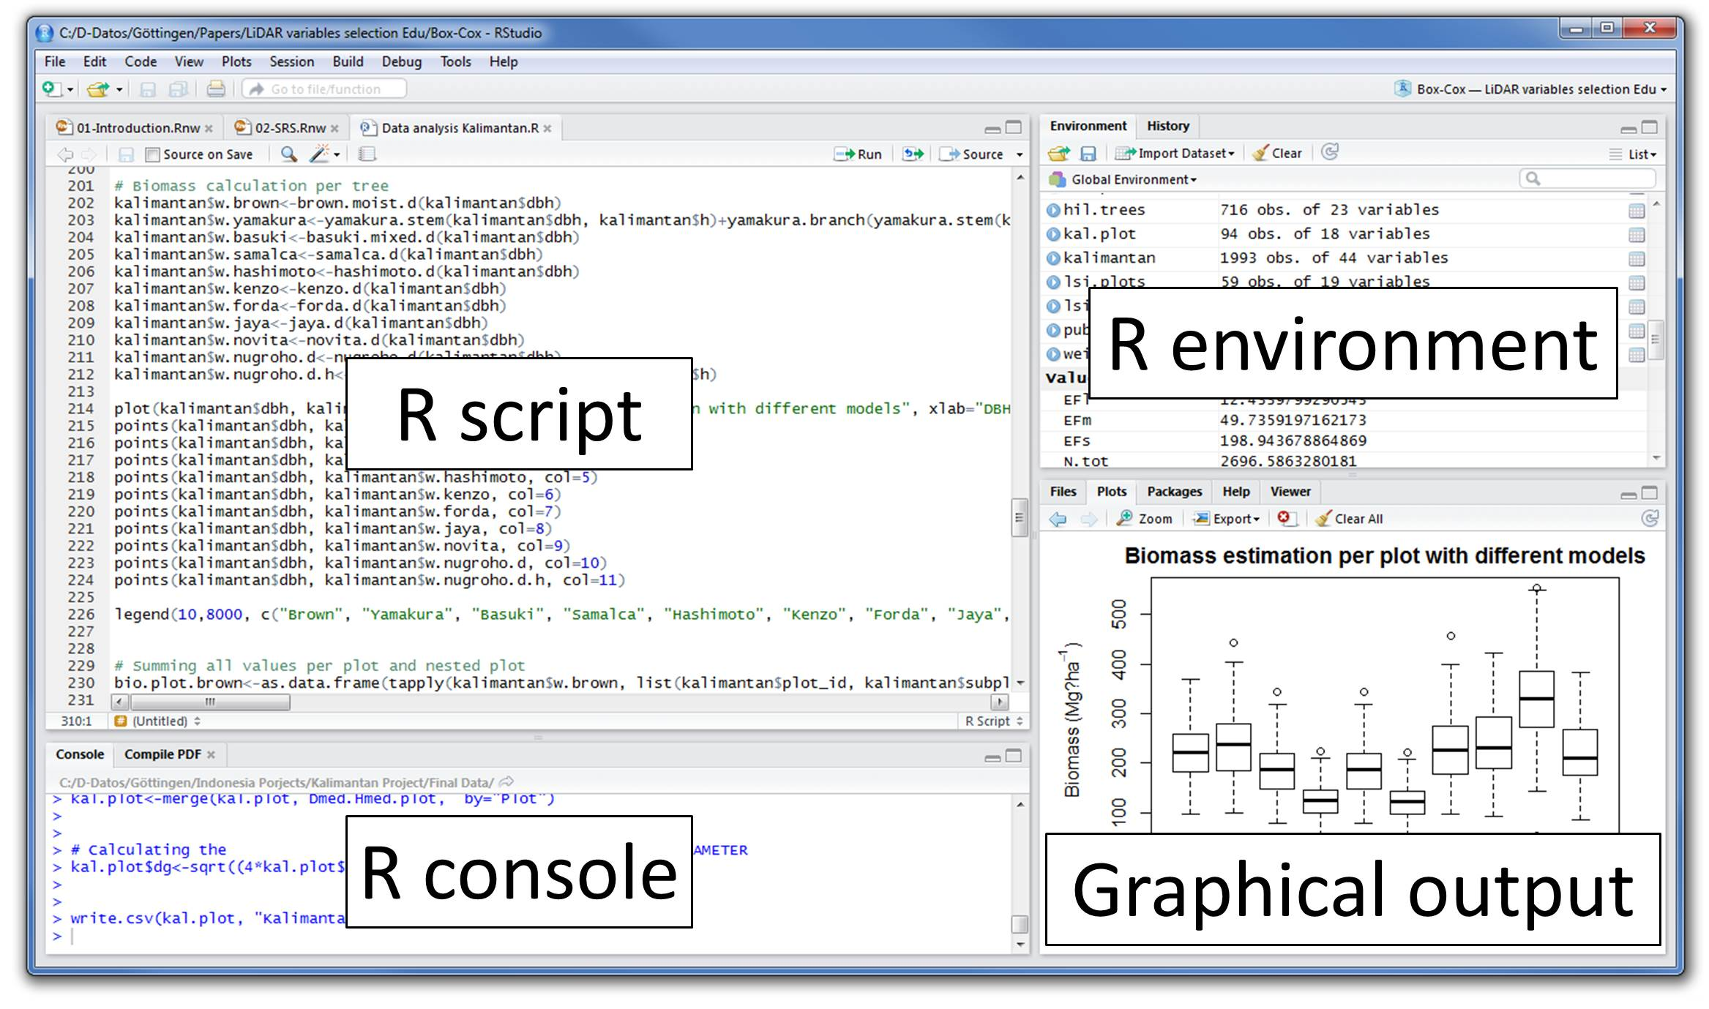
Documentation for functions can be accessed here or via the console: ?function_name
Notes:
Describe what functions each of the labeled sections accomplish:
e.g. script: instructions to be executed that can be stored for re-use and editing; R-scripts are text files that contain the workflow you want to save (i.e. don't work from the console), they should be saved in a folder corresponding to the location of your working directory. The console can be used to check things on the fly.

Slide 7
Packages in R
the capabilities of R are extended through user-created packages, which allow for
specialized statistical analyses
graphical devices
import/export capabilities
reporting tools
...and many more functions
in addition to a core set of packages included with R, more packages can be downloaded from repositories like
the Comprehensive R Archive Network (CRAN)
GitHub
Bioconductor
...and others

Slide 8

Setup Instructions
Download and install the current version of R from https://cran.rstudio.com/
Download and install RStudio Desktop from https://www.rstudio.com/products/rstudio/download
Explore additional packages of interest based on discipline/application using the CRAN Task Views page: https://cran.r-project.org/web/views/
Download and install packages of interest via the console in RStudio:
install.packages(“package_name”)
library(“package_name”)

Slide 9
Overview & Setup
Data Types & Data Structures
Tools for Data Wrangling & Exploratory Data Analysis
Conducting Statistical Tests
Discussion, Feedback, & Further Resources

Slide 10
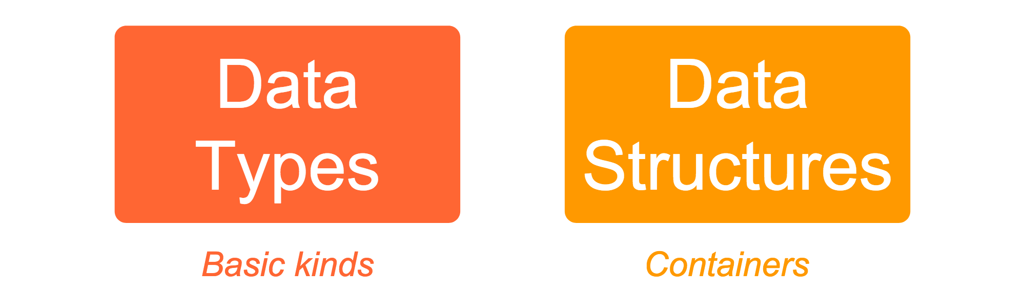
Data for Programming Languages
Data types are classifications of data that define the operations that can be done on the data, its meaning, and how it can be stored.
Data structures are specialized formats for organizing and storing data that enable its efficient access and modification

Slide 11
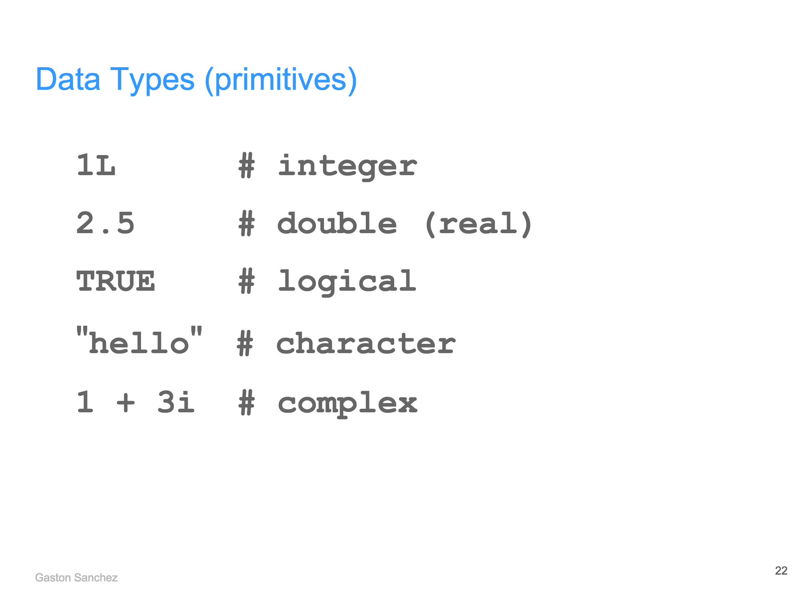
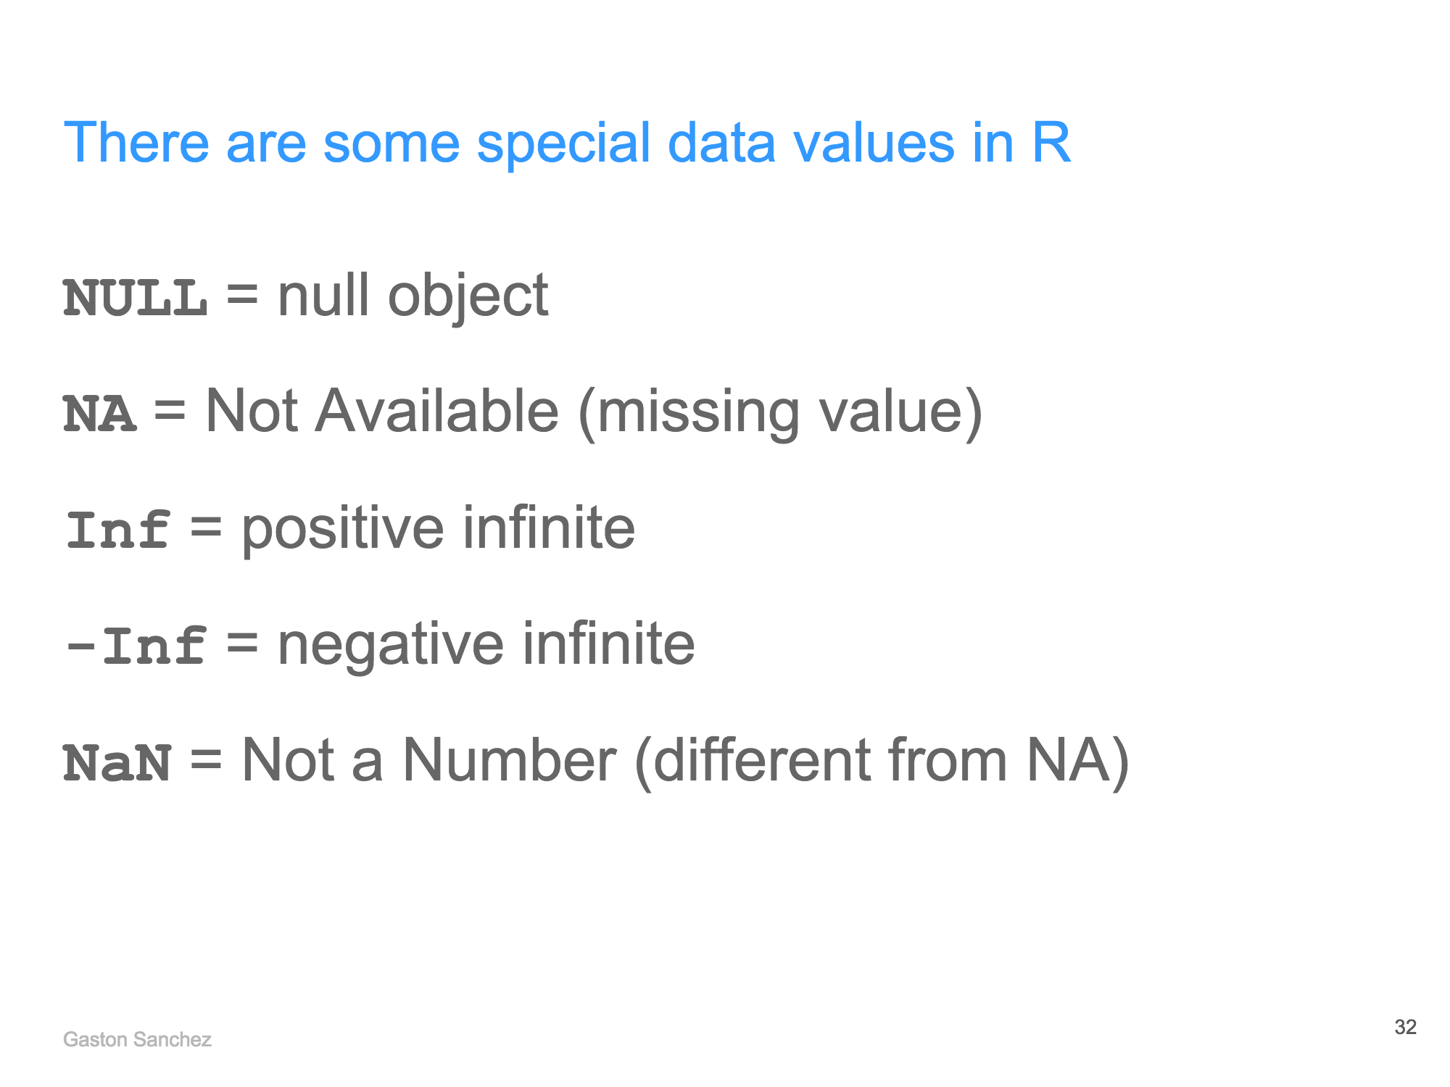
Common Data Types in R
integer (whole numbers)
double (real, decimal numbers)
logical (boolean)
character (strings)
To check data type: typeof()
To convert between data types:
as.integer()
as.numeric()
as.logical()
as.character()

Slide 12
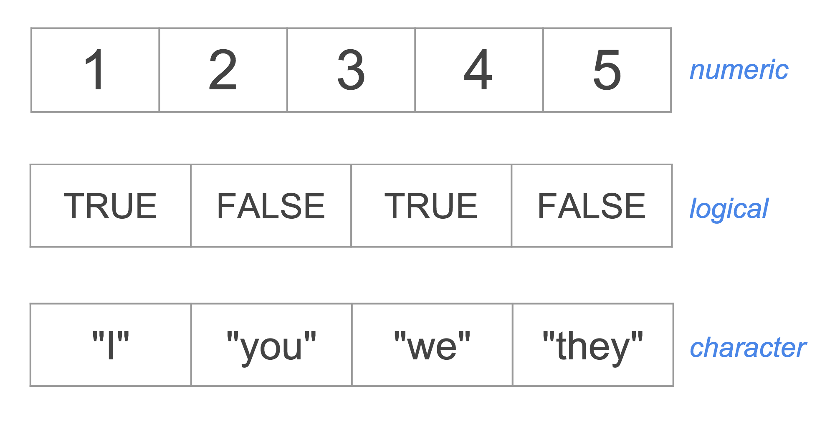

Data Structures in R
a vector, the most basic data structure in R, is made up of contiguous cells containing values of the same data type
vectors are commonly subset using a numeric or logical index:
x <- c(1, 2, 3, 4, 5)
y <- c(TRUE, FALSE, TRUE, FALSE)
z <- c(“I”, “you”, “we”, “they”)
y[c(1, 3)]
TRUE TRUE
x[x > 1]
2 3 4 5
Notes:
Go into a bit more detail on what is happening when you subset x[x>1], i.e. that x>1 creates a boolean vector, then the indexing function returns the values of x for which that vector is true

Slide 13
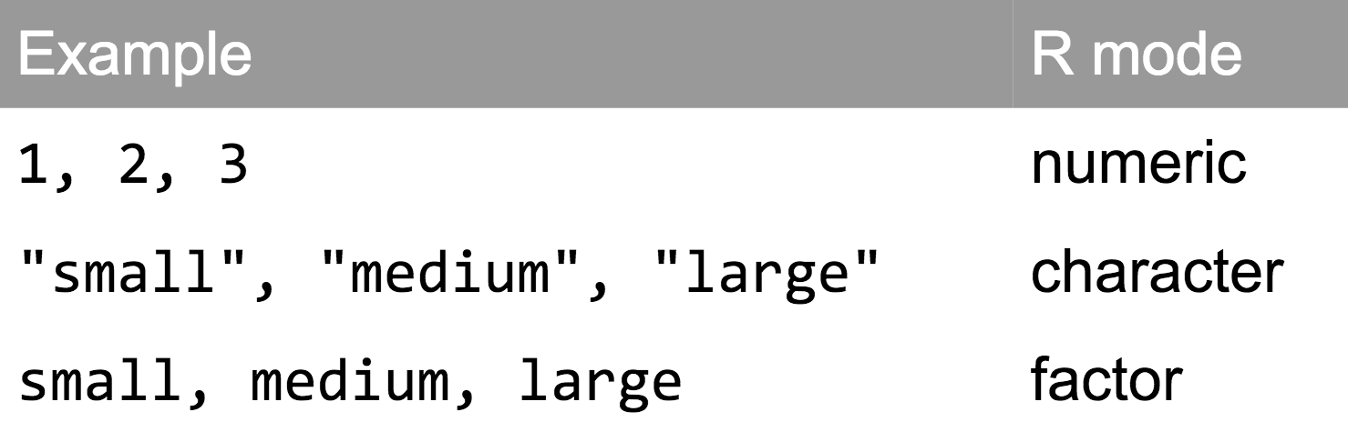
Data Structures in R
a factor is another data structure designed to handle categorical data
factors are internally stored as vectors of integers and behave a lot like vectors but have their own special properties
size <- c(“small”, “medium”, large”)
size <- factor(size)
small
medium
large
factor

Slide 14
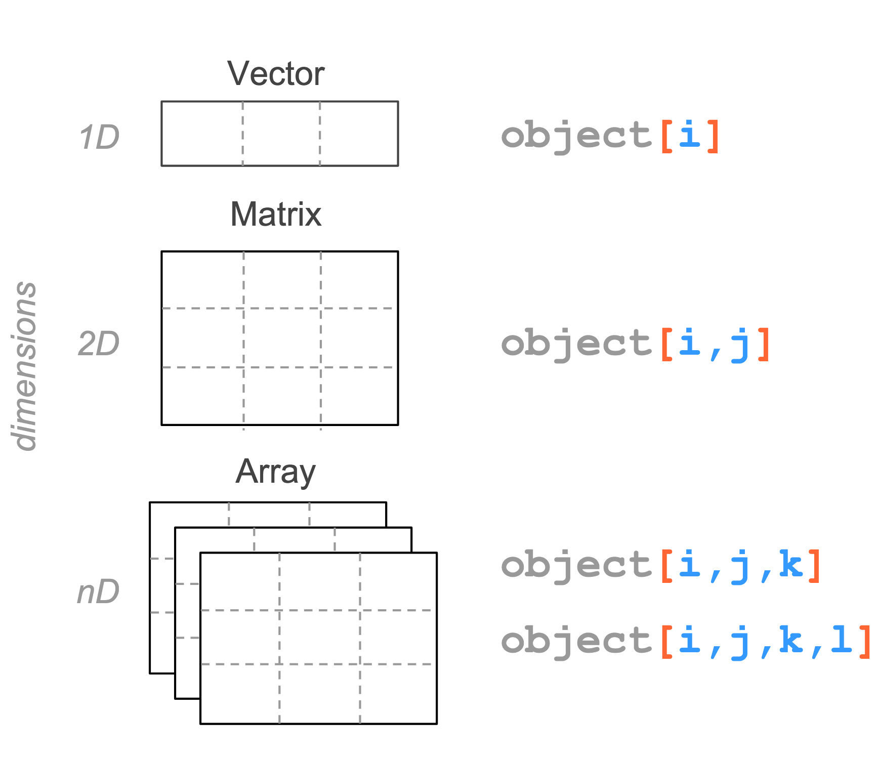
Data Structures in R
matrices and arrays are other data structures that contain values of the same data type (atomic structures)
1 4 7
2 5 8
3 6 9
1 4 7
2 5 8
3 6 9
a <- 1:9
A <- matrix(a, nrow = 3, ncol = 3)
b <- 1:27
dim(b) <- c(3, 3, 3)
Notes:
can transform a vector in an n-dimensional array by giving it a dimensions attribute, which is a numeric vector with as many elements as desired dimensions

Slide 15
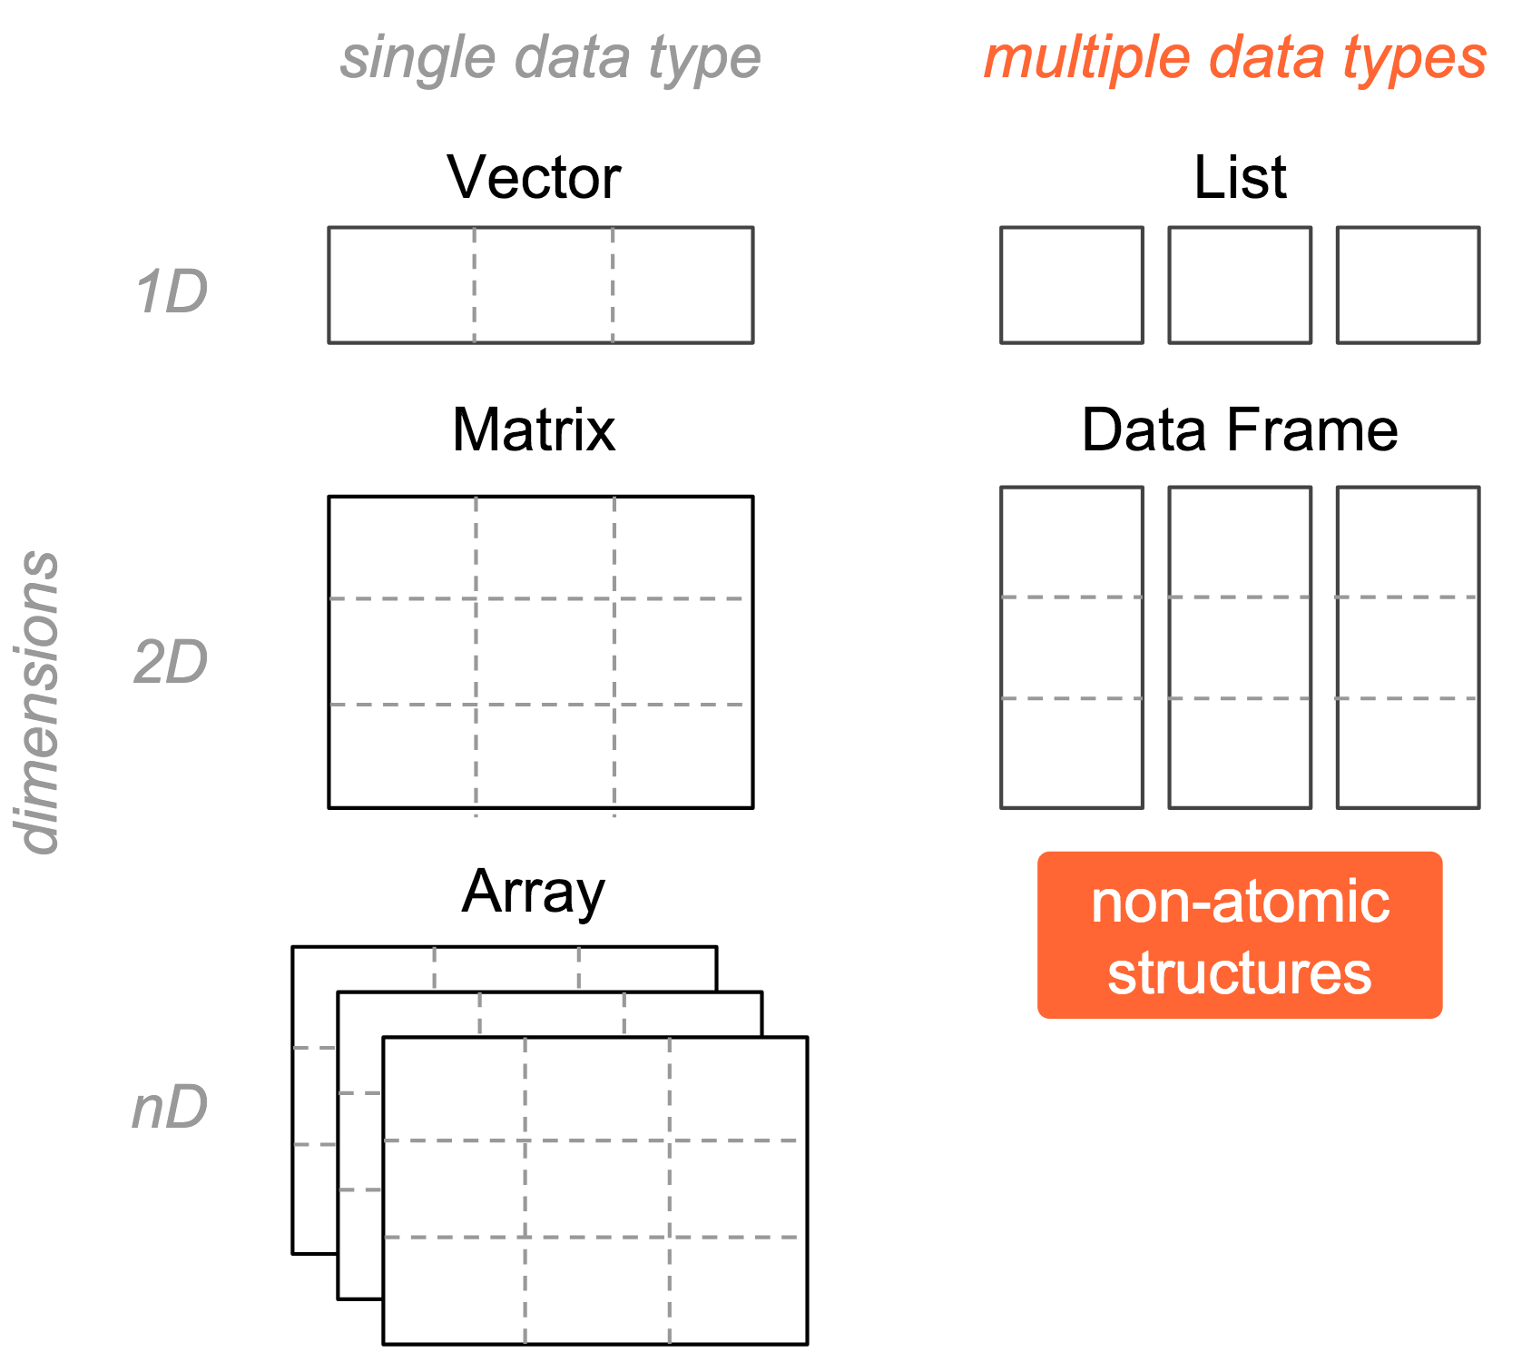
Data Structures in R
lists and dataframes are non-atomic structures that can store values of more than one data type
A list, R’s most general data structure, can contain any other type of data structure (even other lists)
A dataframe is the primary data structure R uses for handling tabular datasets. It is treated by R as a special kind of list (stored in R as a list of vectors or a list of factors).

Slide 16
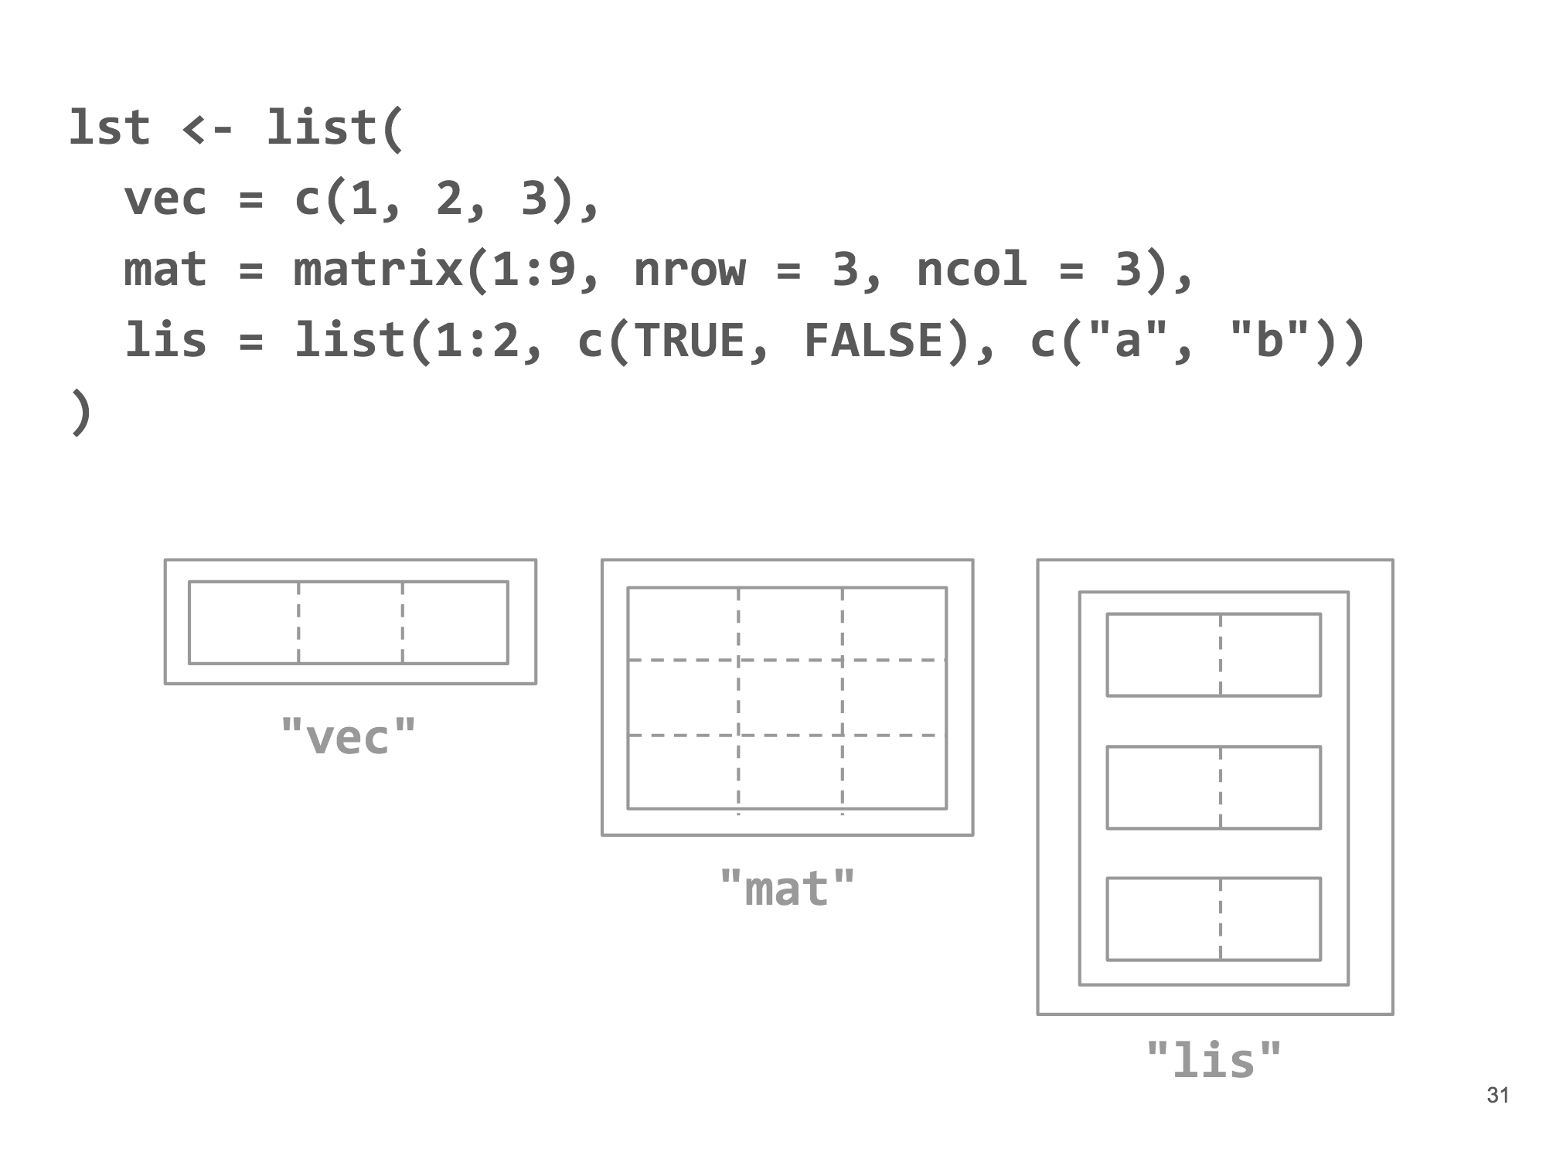
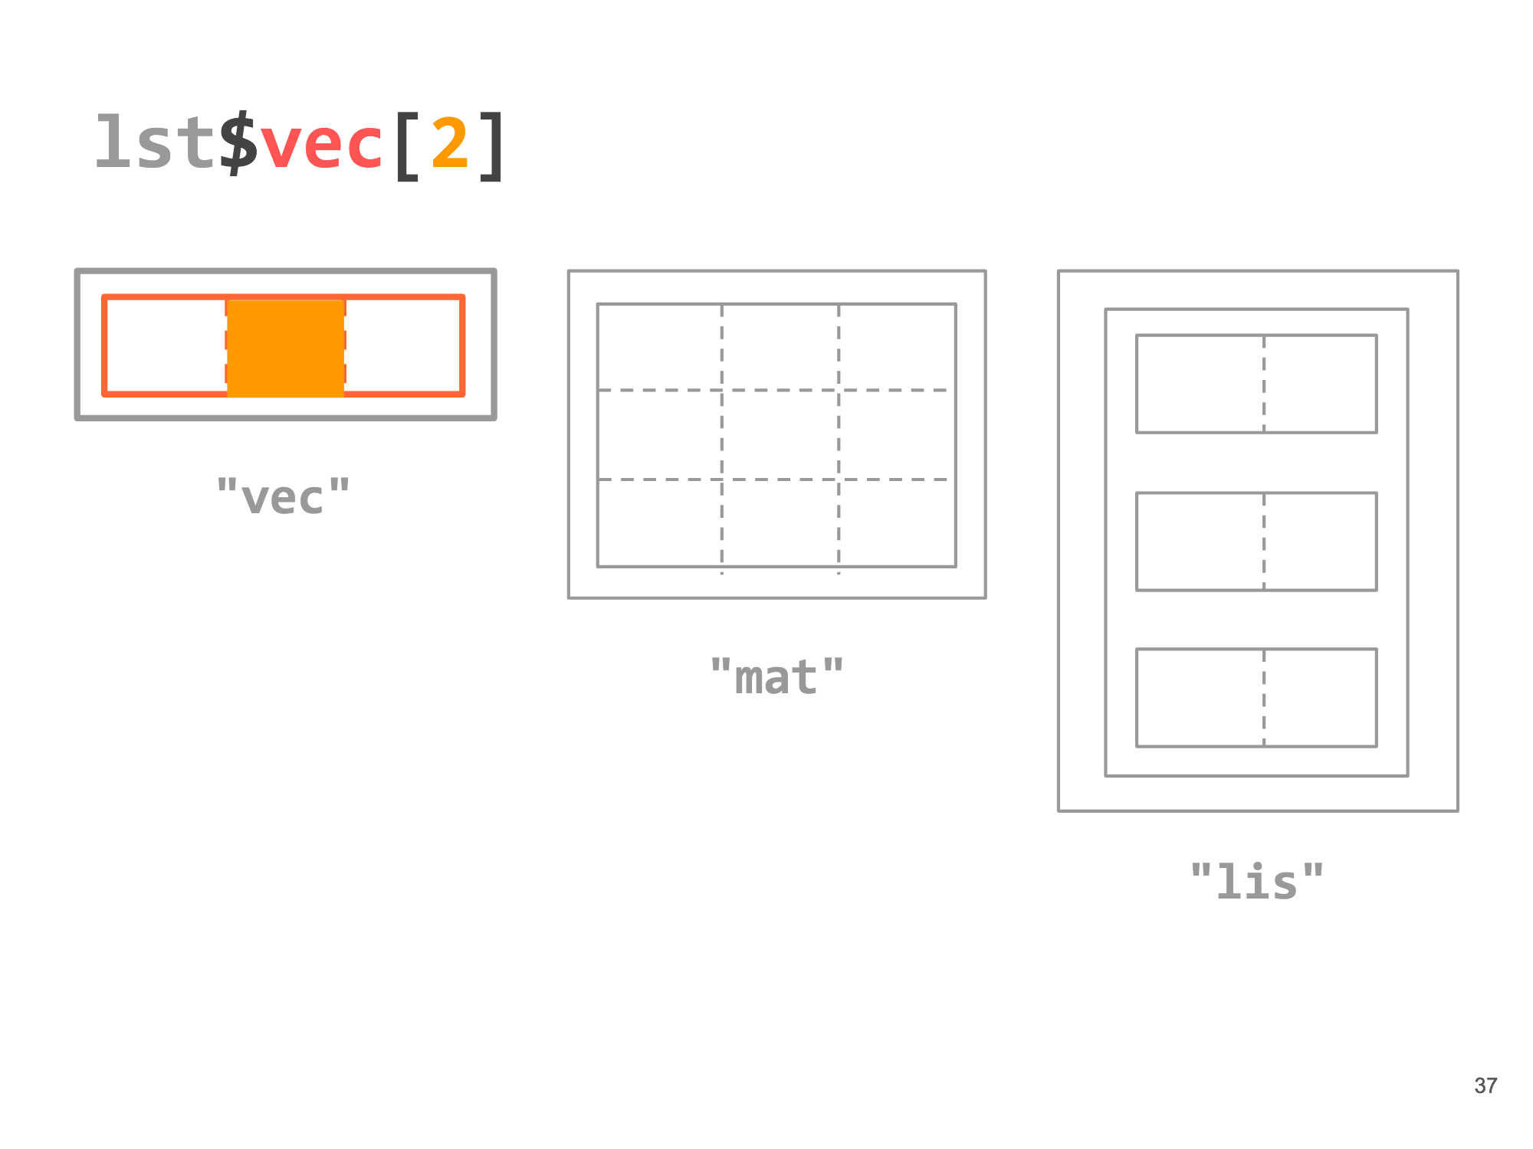
Data Structures in R
a list can be subset using bracket [ ] or dollar $ notation (if its elements are named)
lst$vec[2] or lst[[1]][2]
Notes:
[[ can be used with a character string matching a named element or a _single_ integer, and will return unlisted contents of the corresponding list entry. [ can be used with multiple integers or a vector of names, and returns a list of the corresponding entries.

Slide 17
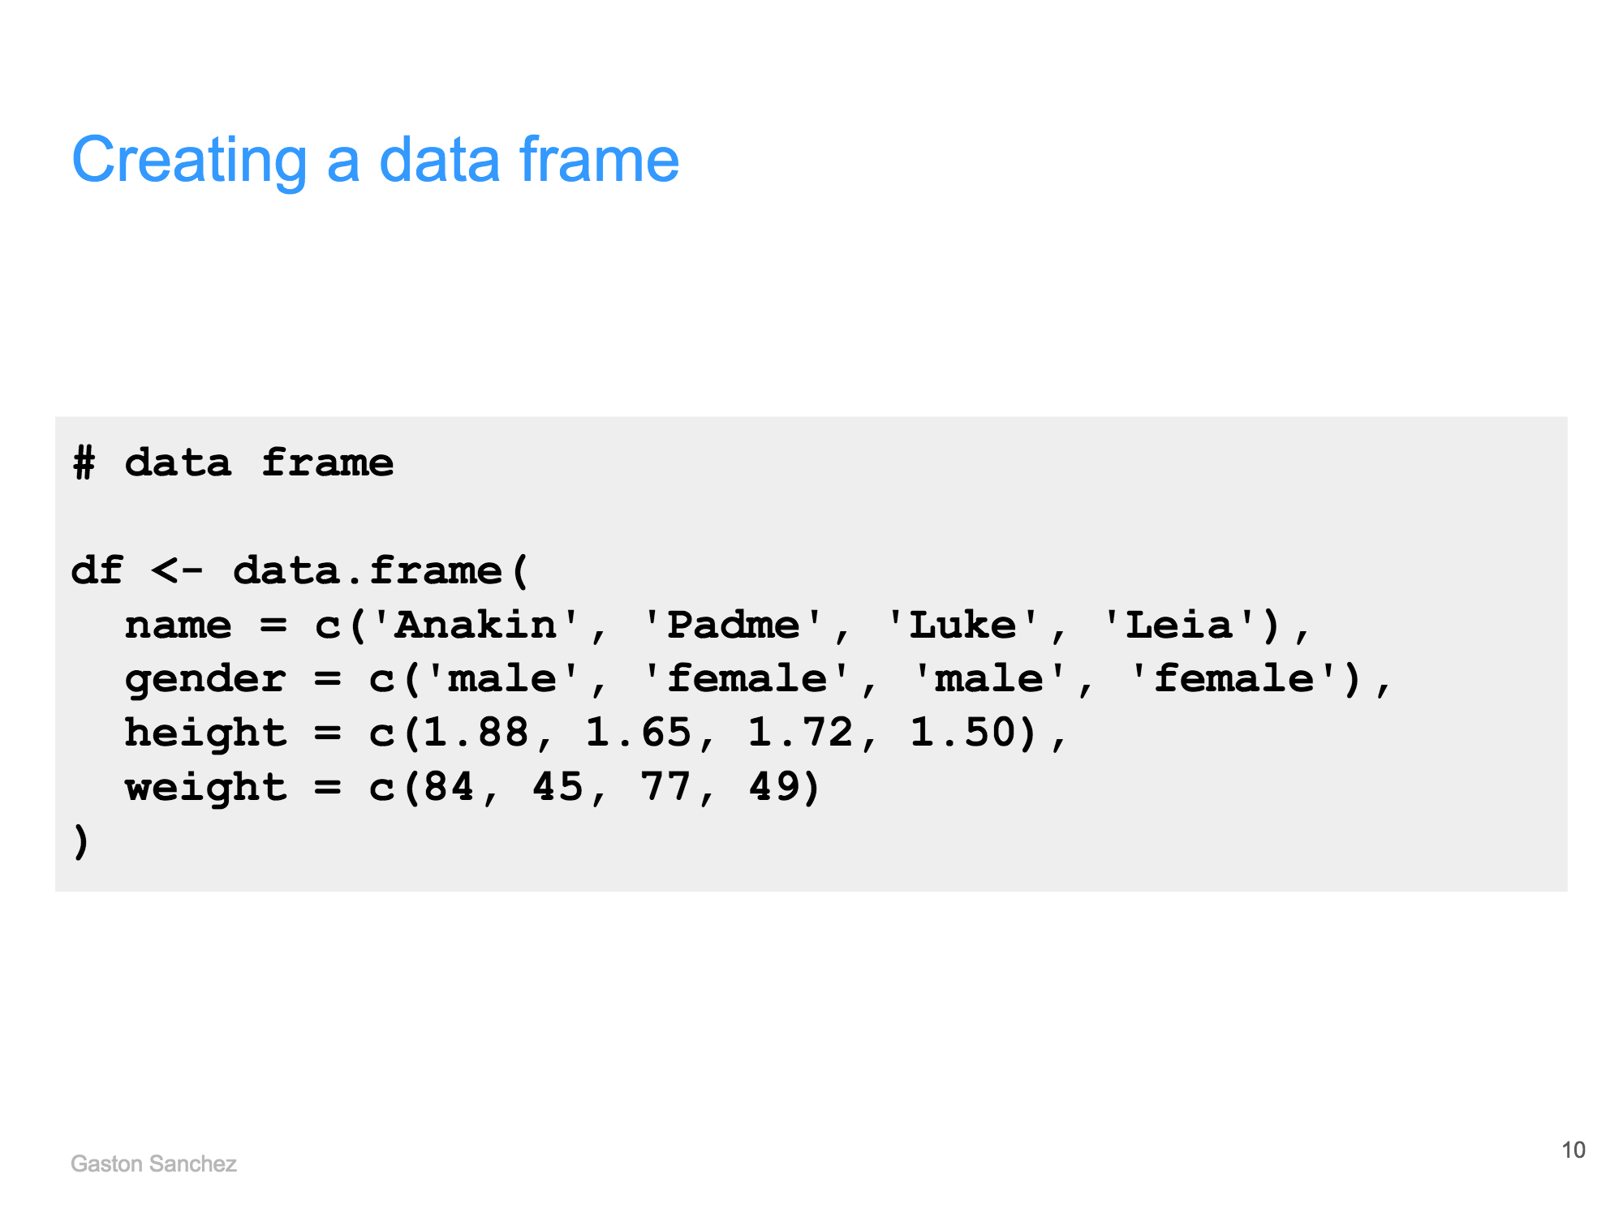
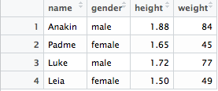
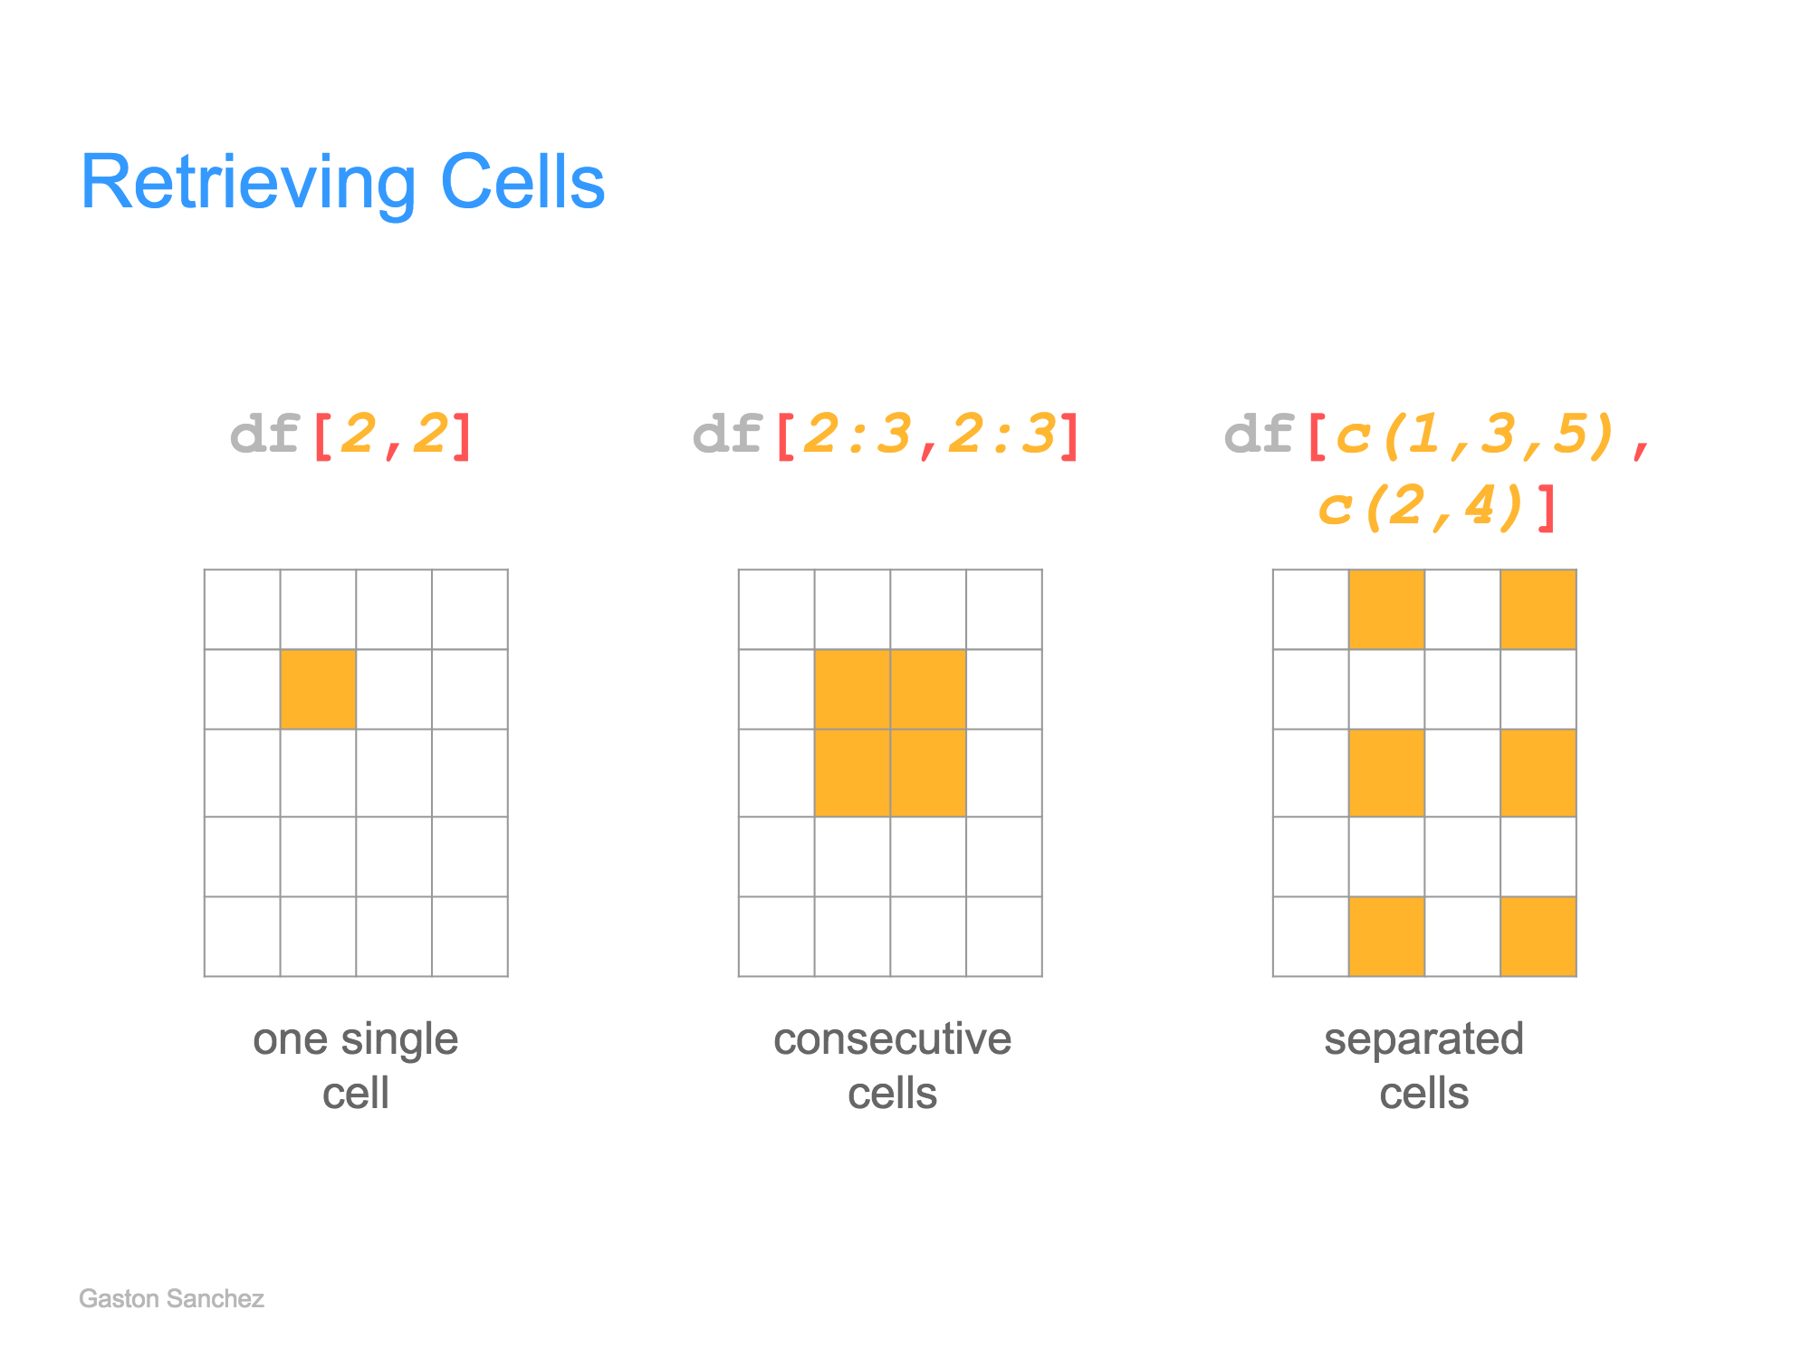
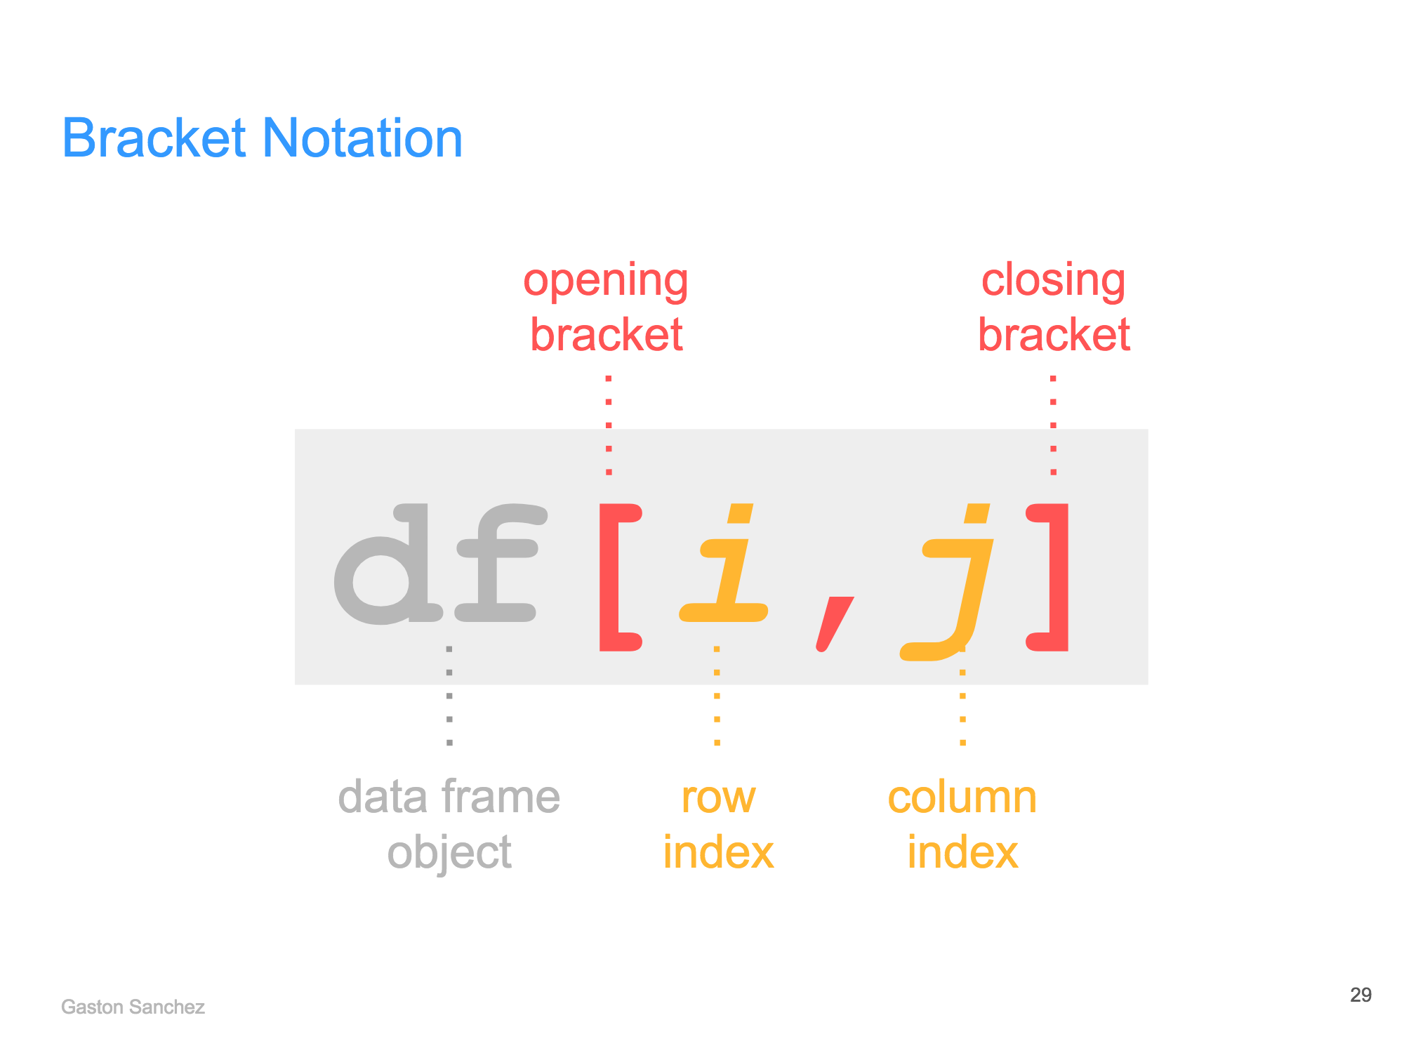
Data Structures in R
creating a dataframe:
subsetting a dataframe:
Notes:
to retrieve cells, can also
(1) exclude cells by adding a “-” sign
(2) retrieve entire row/columns by leaving the column/row field blank
(3) retrieve cells using logical indices
(4) retrieve columns using dollar notation (df$col_name)

Slide 18
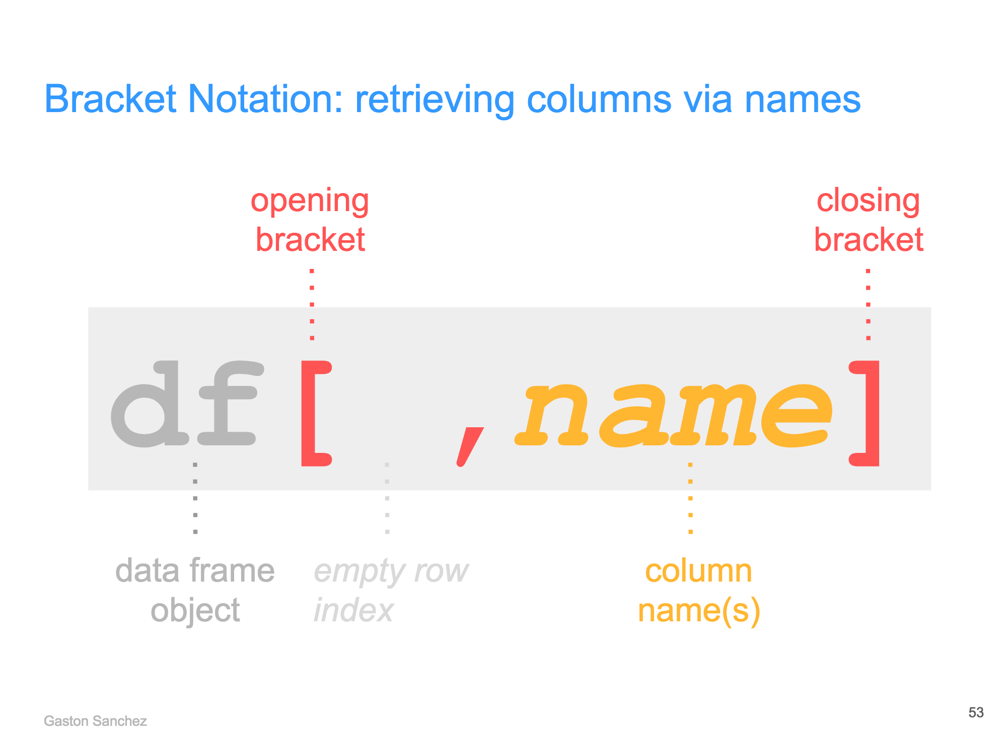
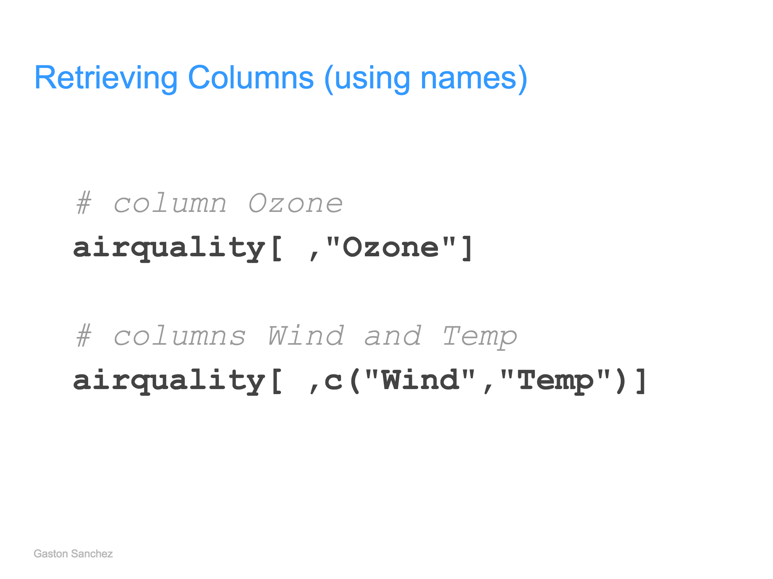
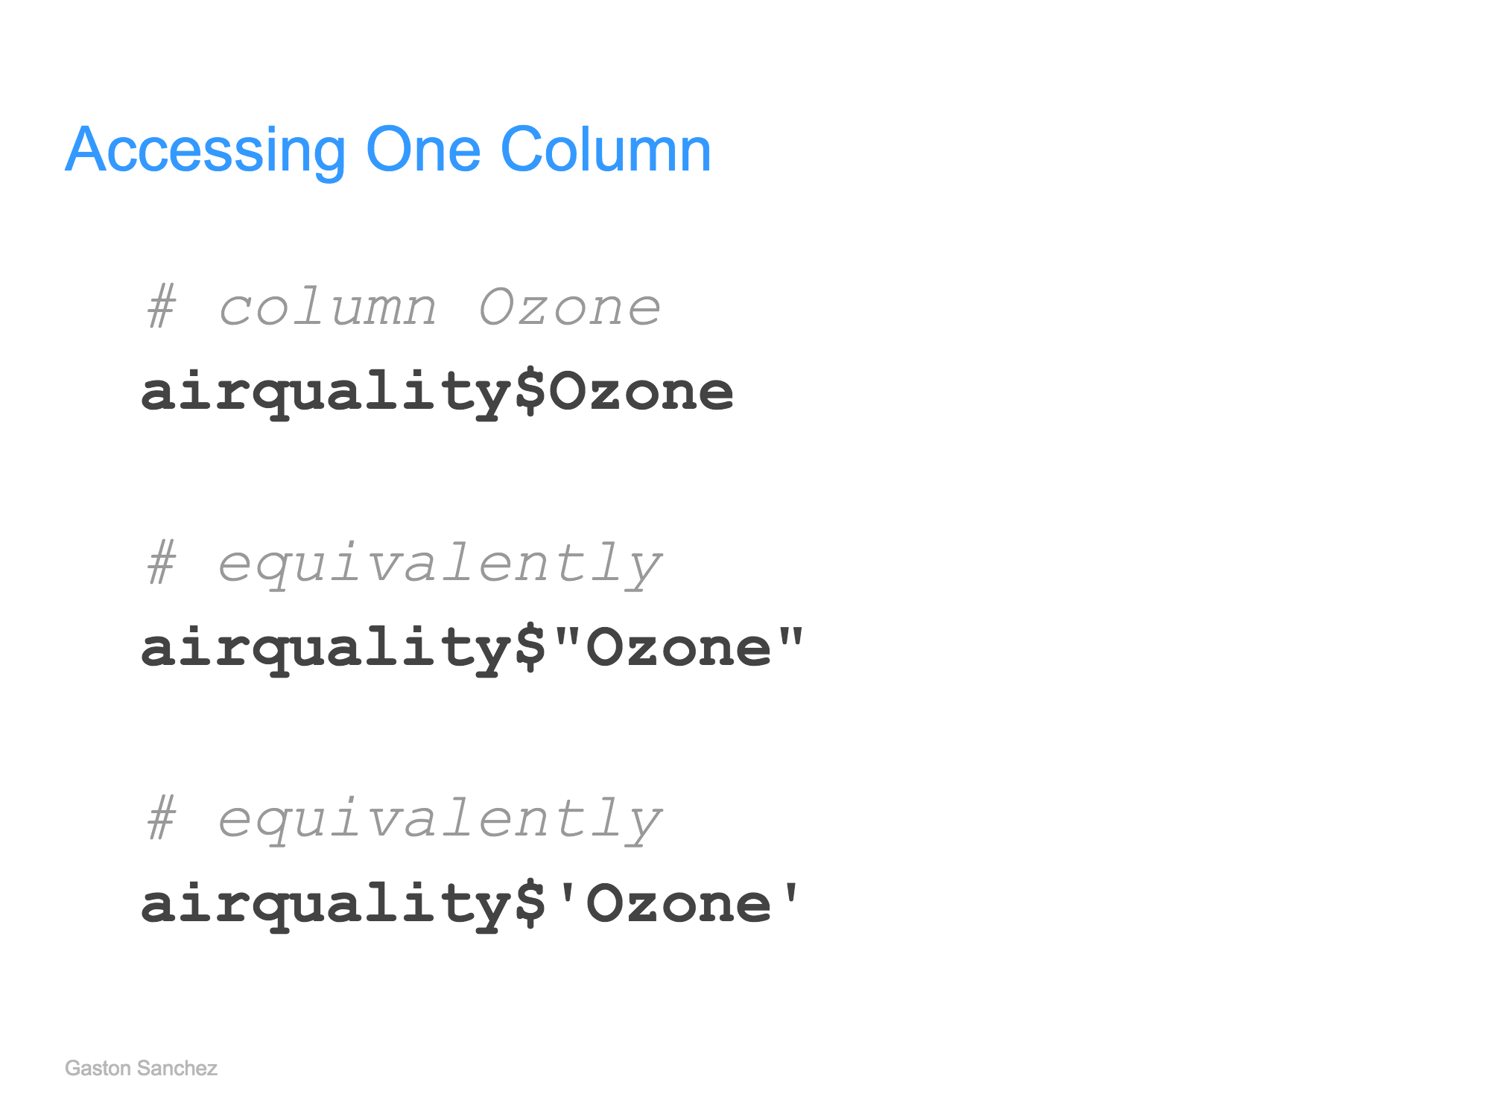
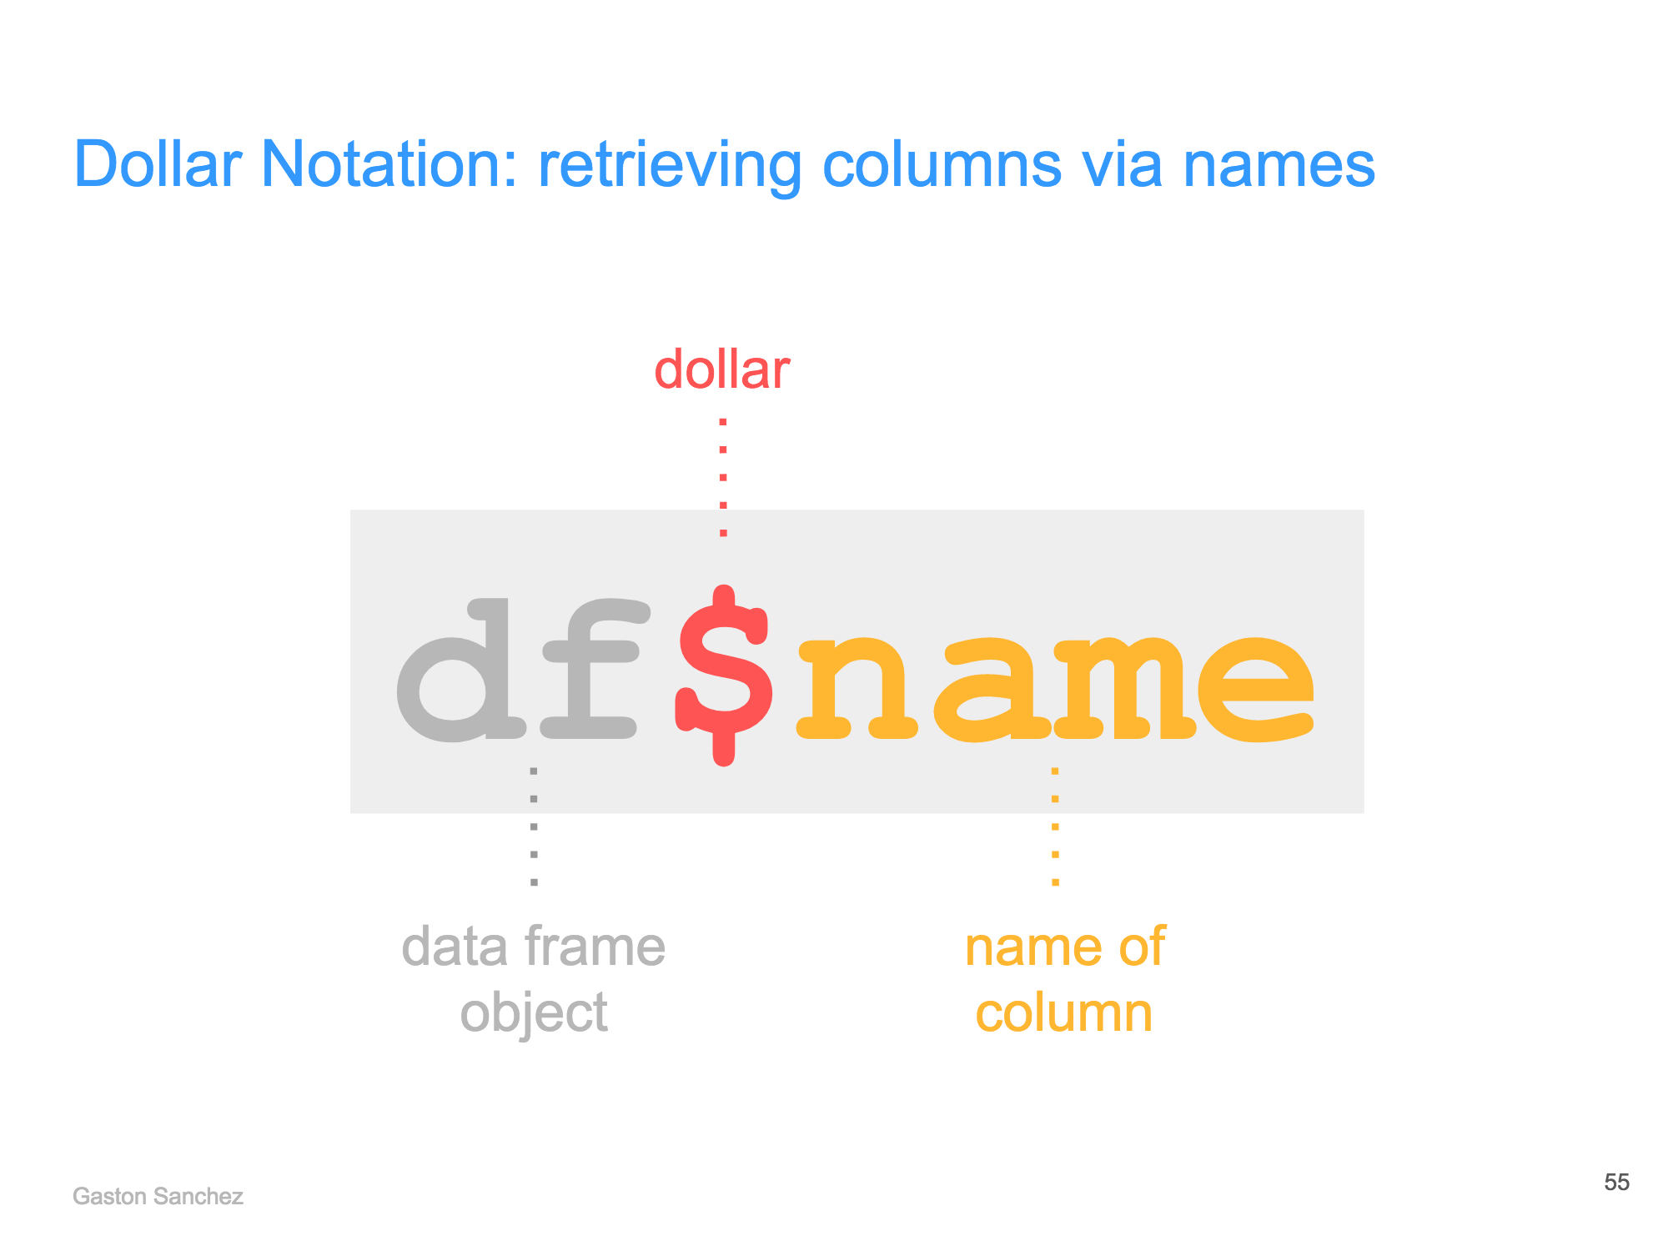
Data Structures in R
selecting dataframe columns using names:
selecting dataframe column using $ notation:
Notes:
to retrieve cells, can also
(1) exclude cells by adding a “-” sign
(2) retrieve entire row/columns by leaving the column/row field blank
(3) retrieve cells using logical indices
(4) retrieve columns using dollar notation (df$col_name)

Slide 19
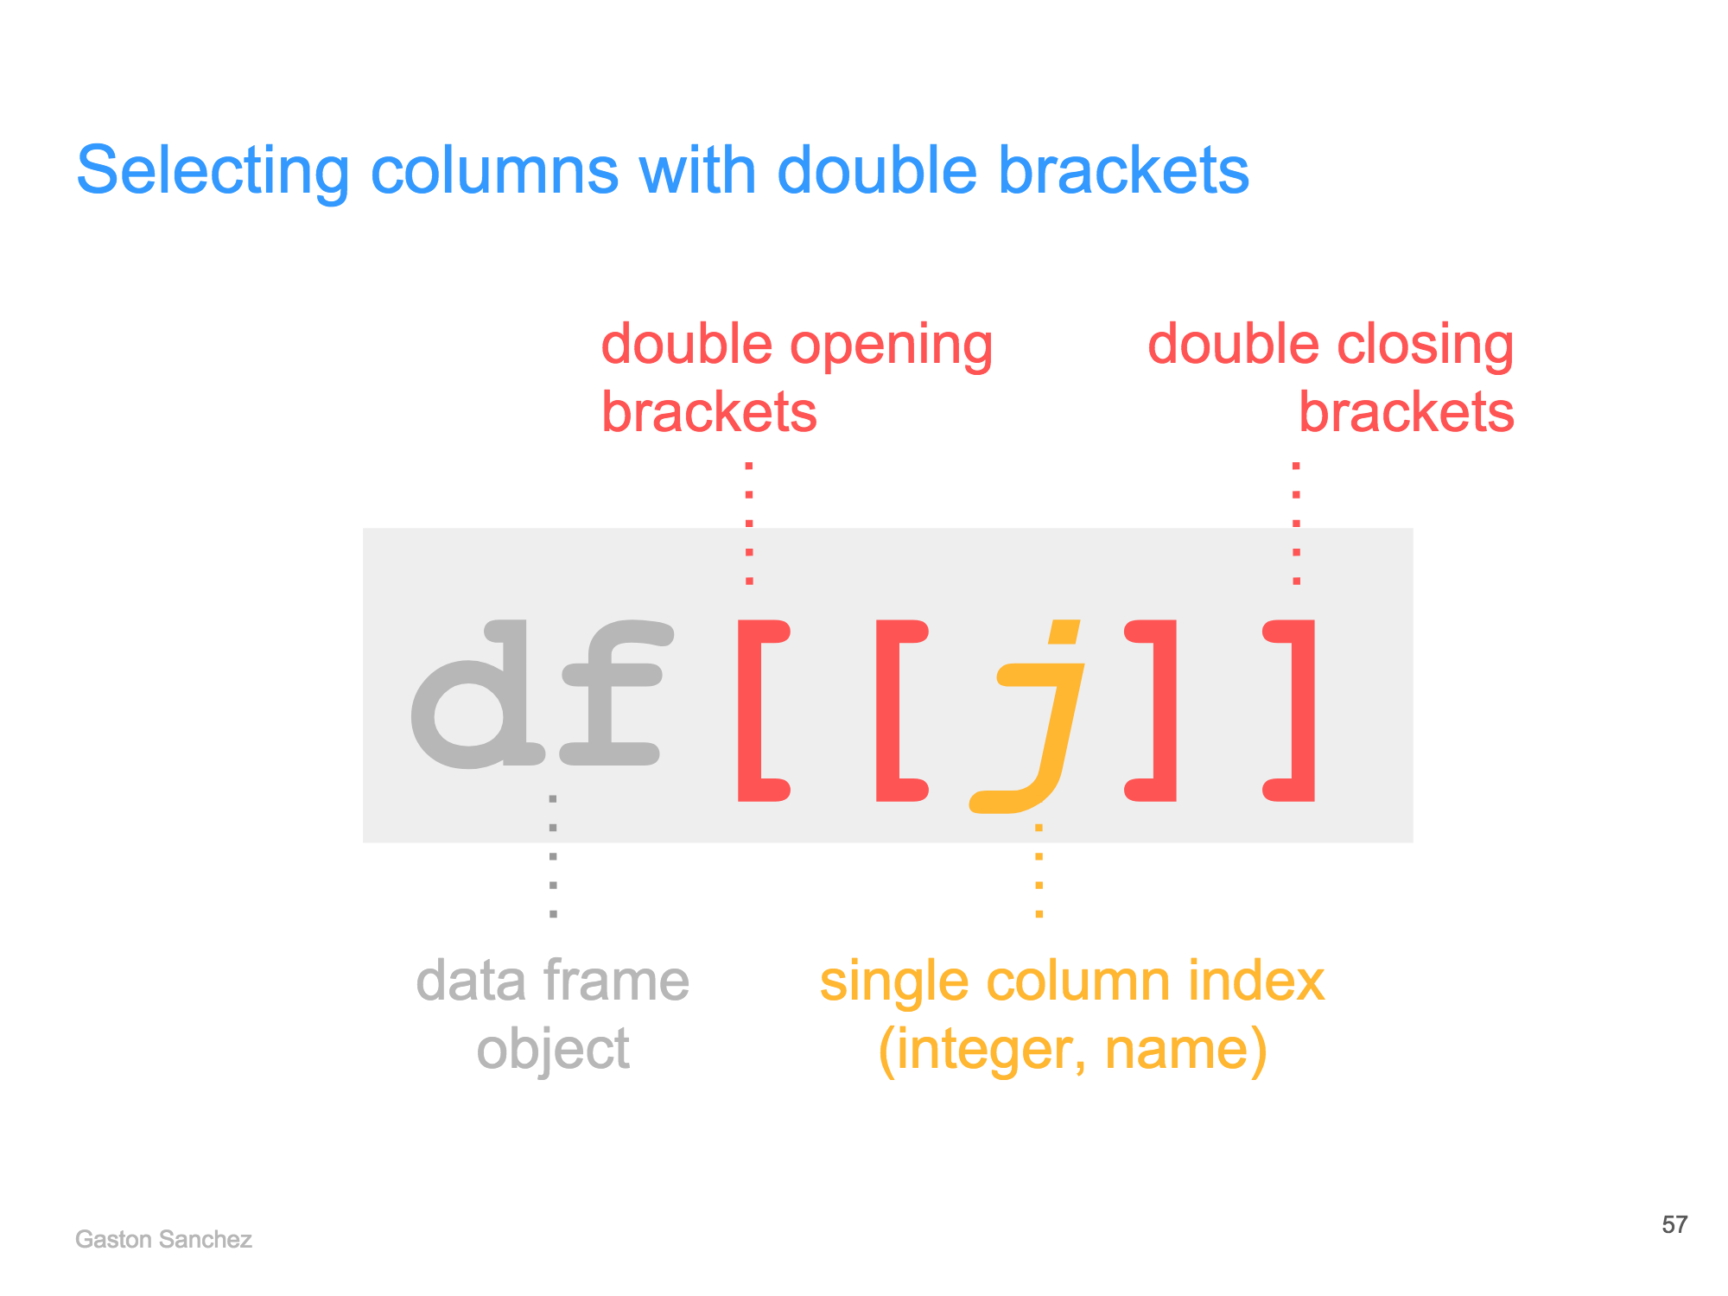

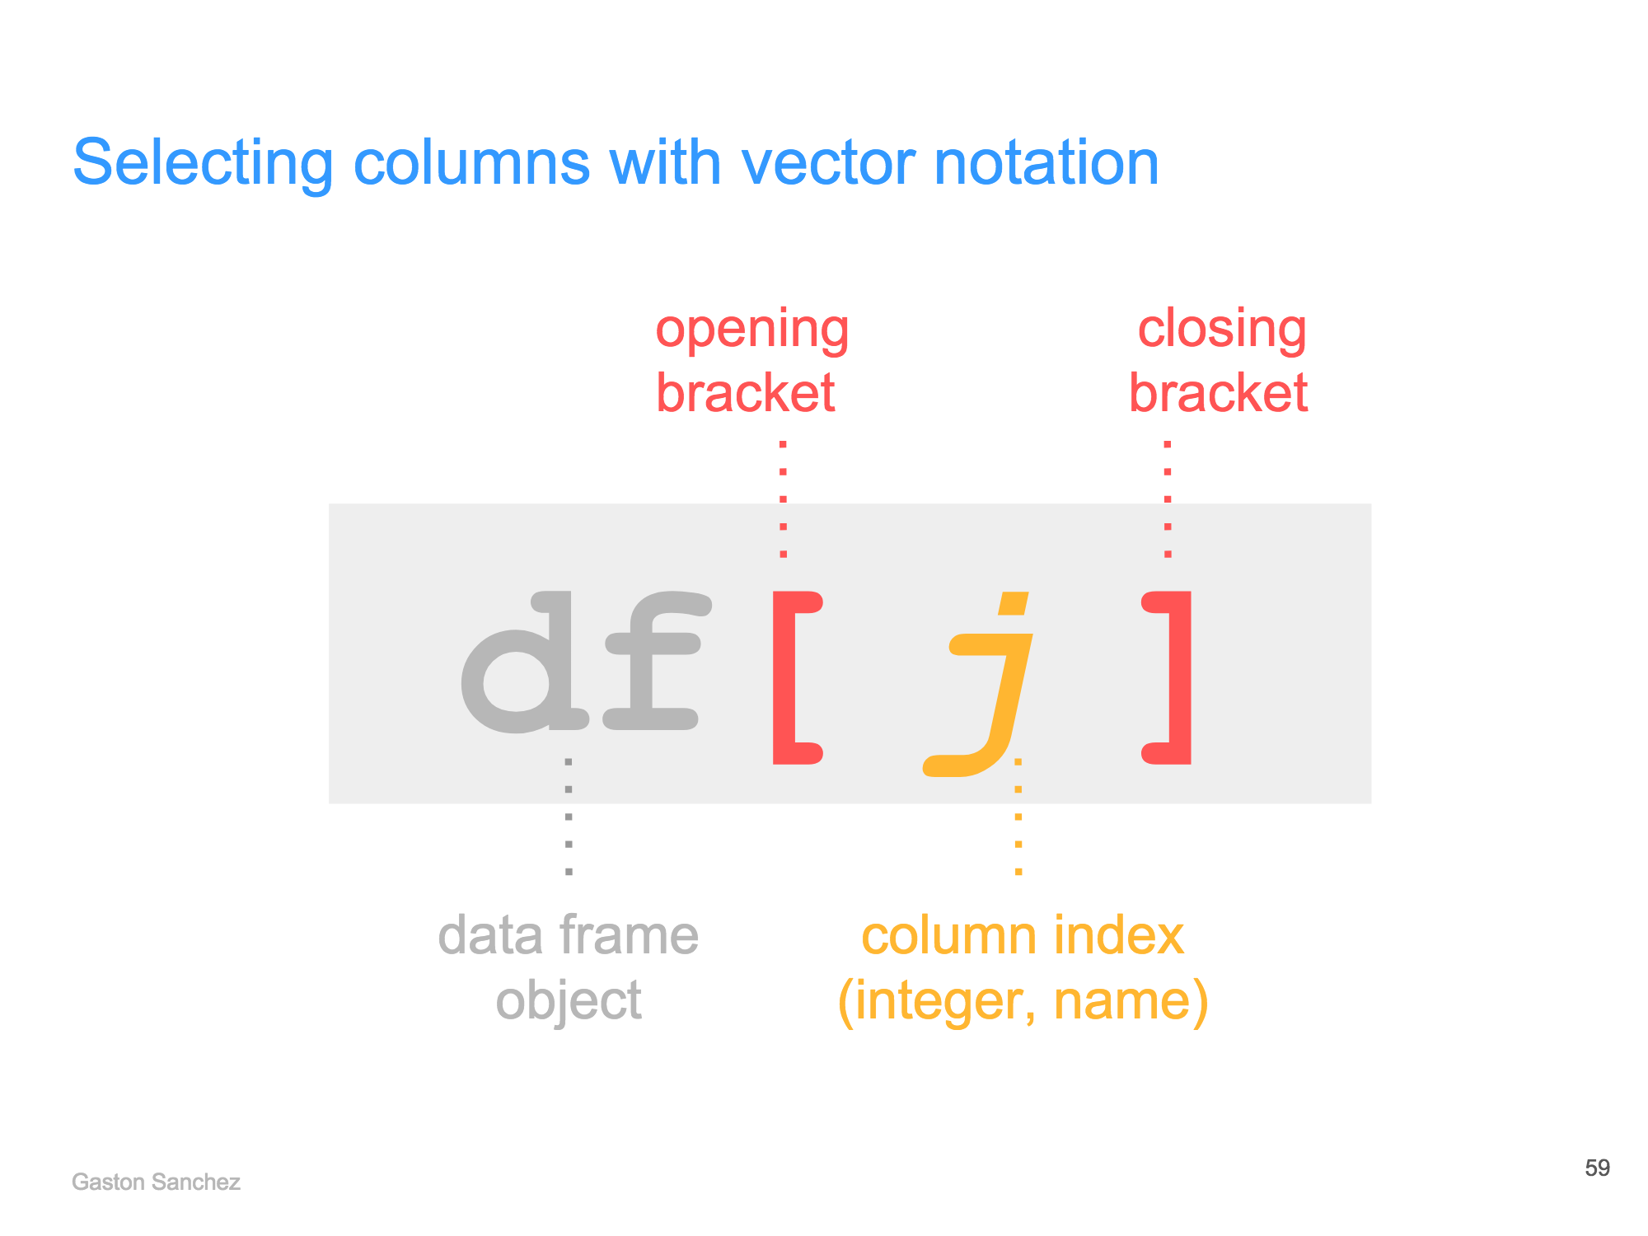
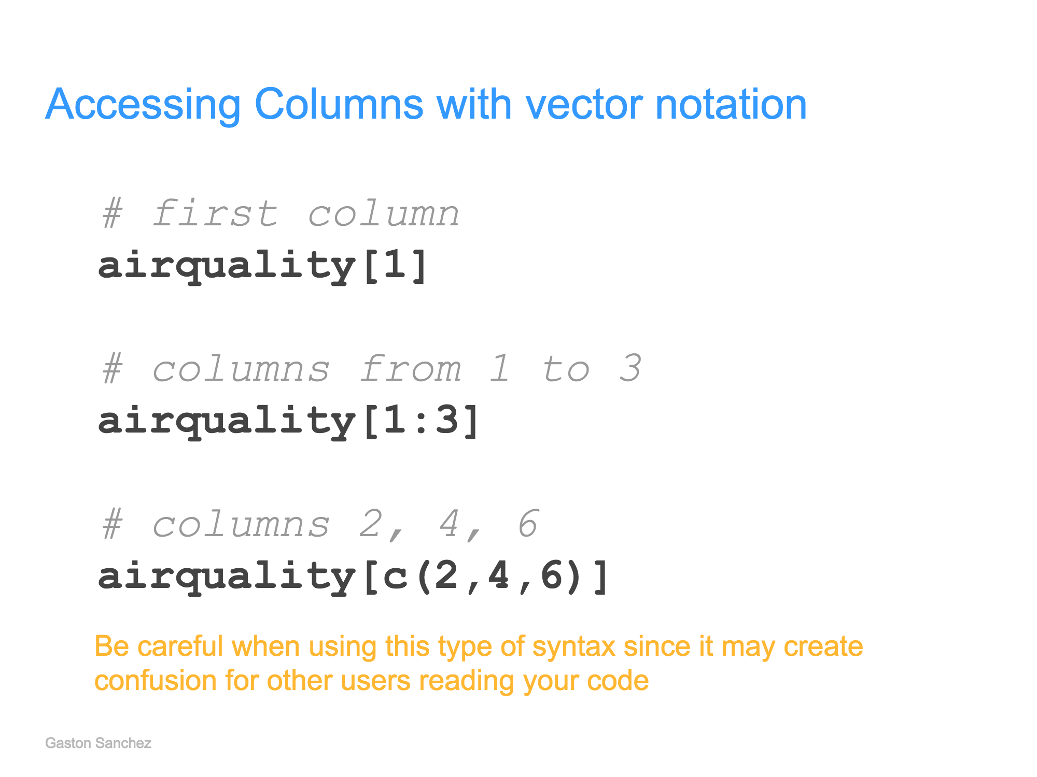
Data Structures in R
selecting dataframe column using double brackets:
selecting dataframe columns using vector notation:
Notes:
to retrieve cells, can also
(1) exclude cells by adding a “-” sign
(2) retrieve entire row/columns by leaving the column/row field blank
(3) retrieve cells using logical indices
(4) retrieve columns using dollar notation (df$col_name)

Slide 20
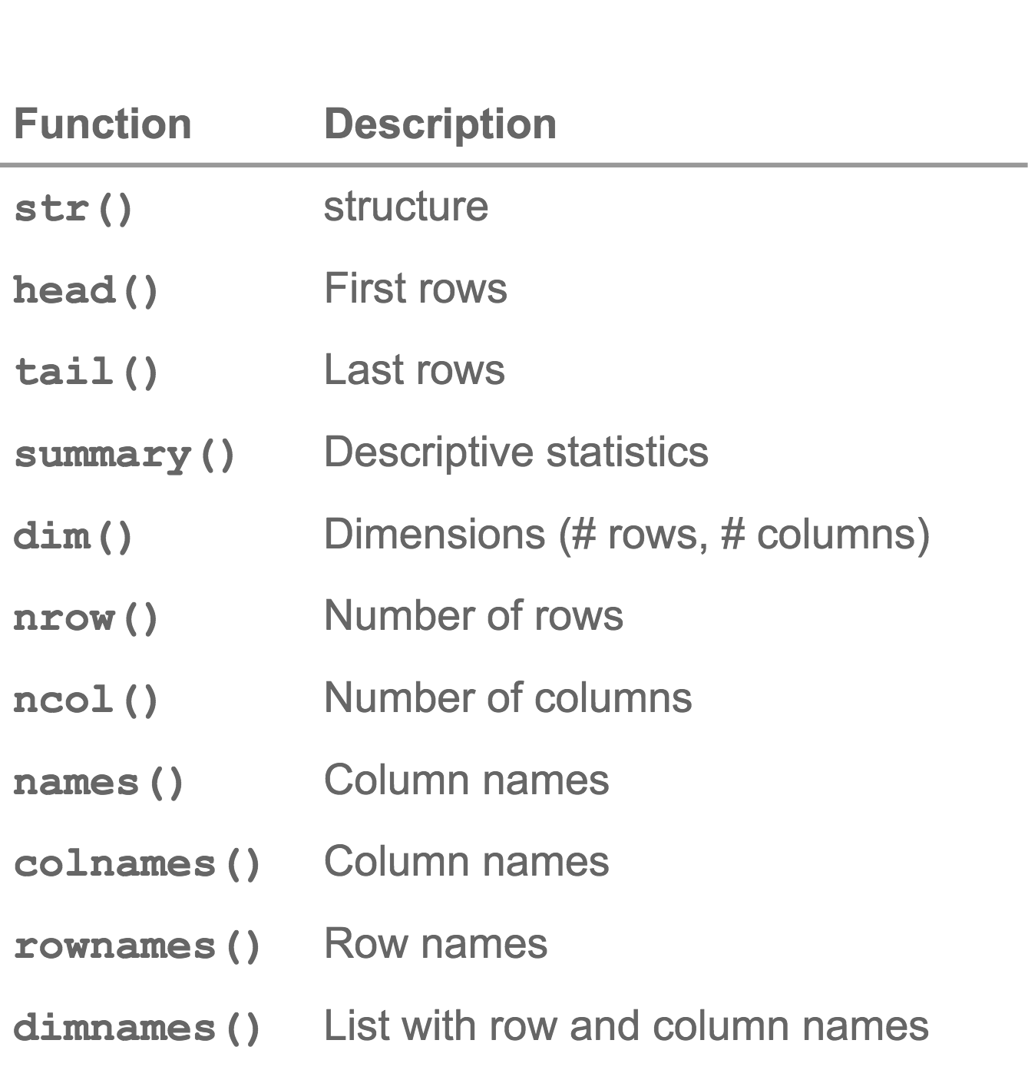
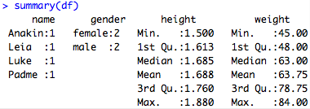
Data Structures in R
inspecting a dataframe:

Slide 21
Overview & Setup
Data Types & Data Structures
Tools for Data Wrangling & Exploratory Data Analysis
Conducting Statistical Tests
Discussion, Feedback, & Further Resources

Slide 22
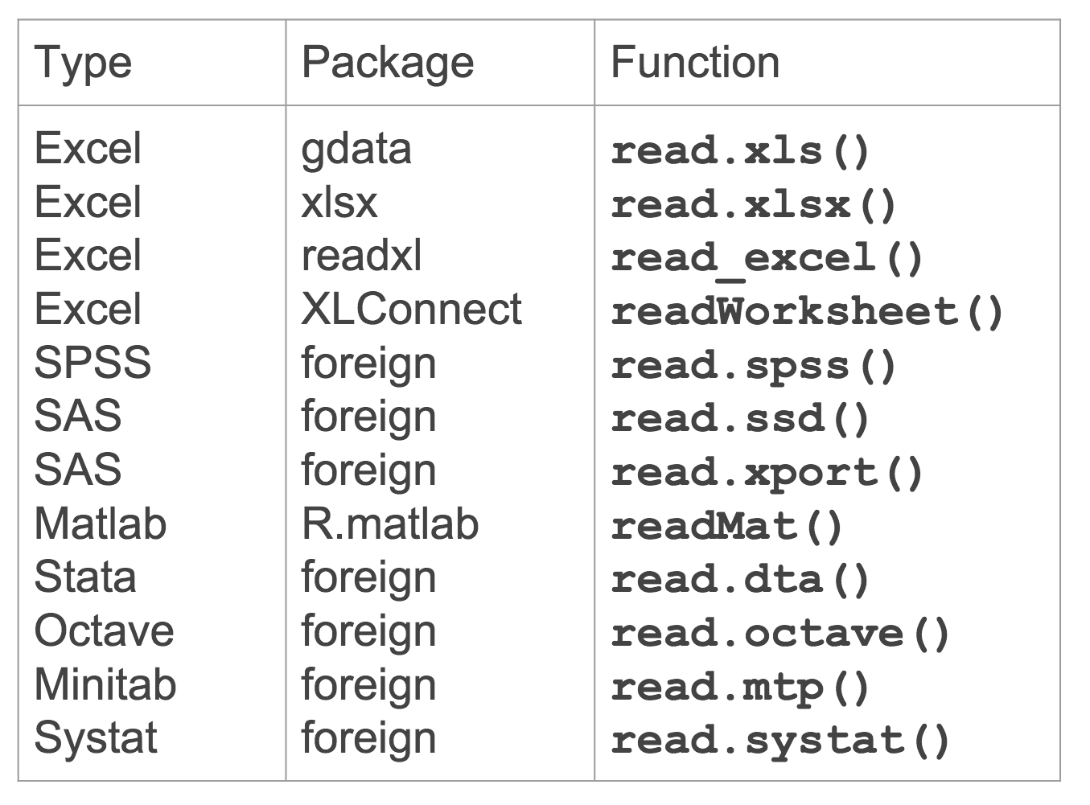
Importing Tabular Data
most plain text files (e.g. .csv, .txt, .dat) can be read using the R base functions read.table(), read.csv(), and read.delim()
e.g. read.table(‘C:/Users/Sichuan CDC/Desktop/file.txt’)
for these functions, it is also good practice to set stringsAsFactors = FALSE to avoid converting all character strings to factors (categorical variables) by default
additional packages may be installed to read other types of files
consider installing readr, a package that makes it easier and faster (10x faster than base functions) to read many types of tabular data

Slide 23
Cleaning and Manipulating Data
the package dplyr provides many user-friendly functions for subsetting and manipulating data, including
mutate() to create new variables with functions of existing variables
select() to pick variables (columns) based on their names
filter() to pick cases (rows) based on their values
arrange() to change the ordering of rows
summarise() to collapse many values down to a single summary
the input and output of all functions is a dataframe, with the 1st argument being the old dataframe, and subsequent arguments describing what to do with that dataframe (using its variable names, without quotes)

Slide 24
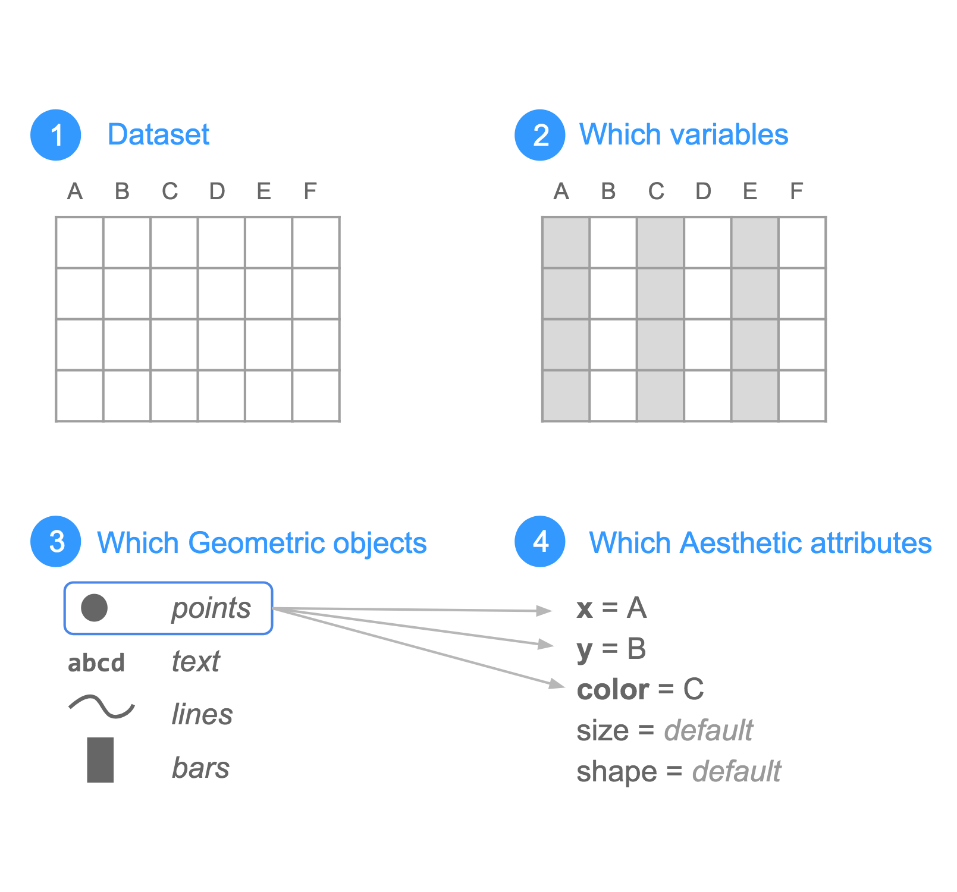
Visualizing Data
the package ggplot2 provides a way to produce visually pleasing graphics with automated inclusion of plot elements like legends, axes, and colors
ggplot2 aims to produce a wide range of statistical graphics with a compact syntax (mapping data to geometric objects and aesthetic attributes) and independent components

Slide 25
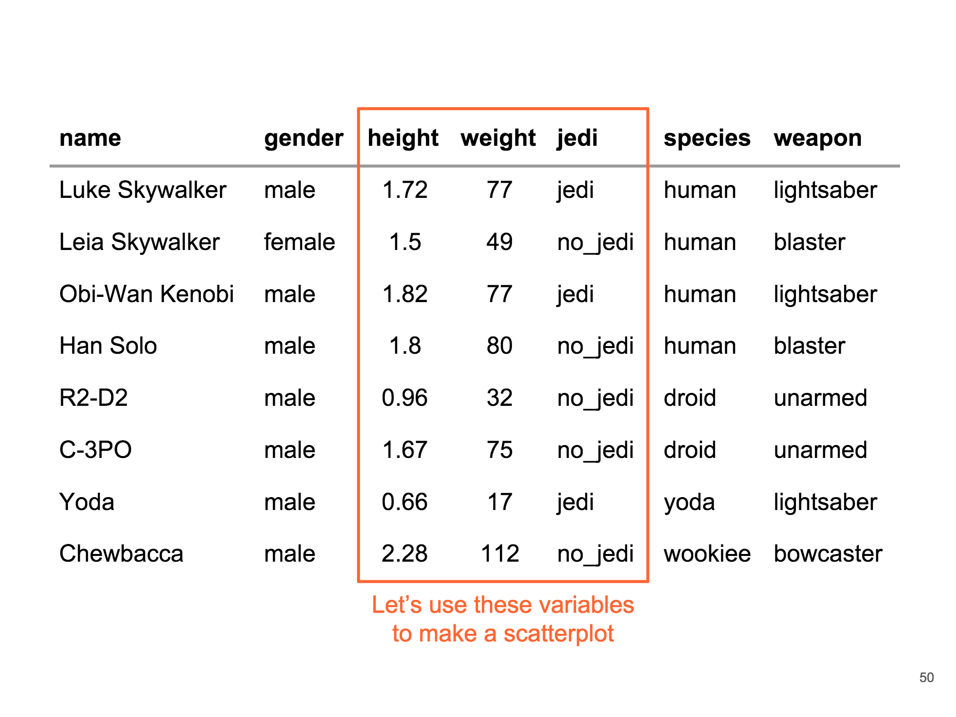
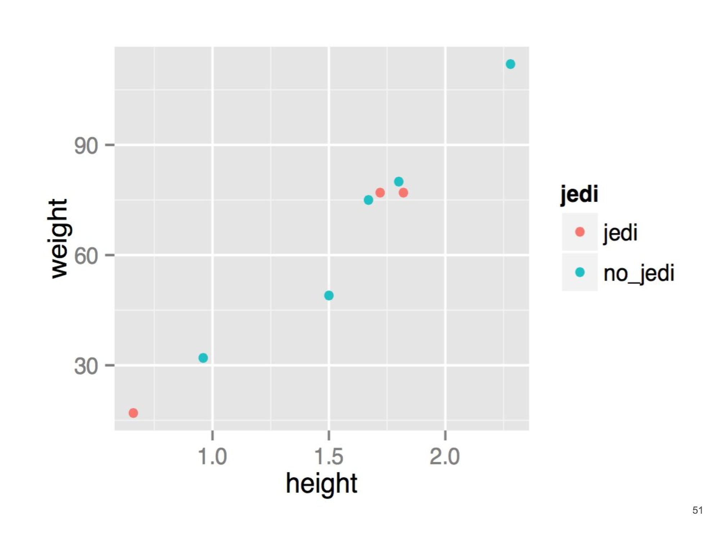
Visualizing Data
example: building a scatterplot with the data from starwars:

Slide 26
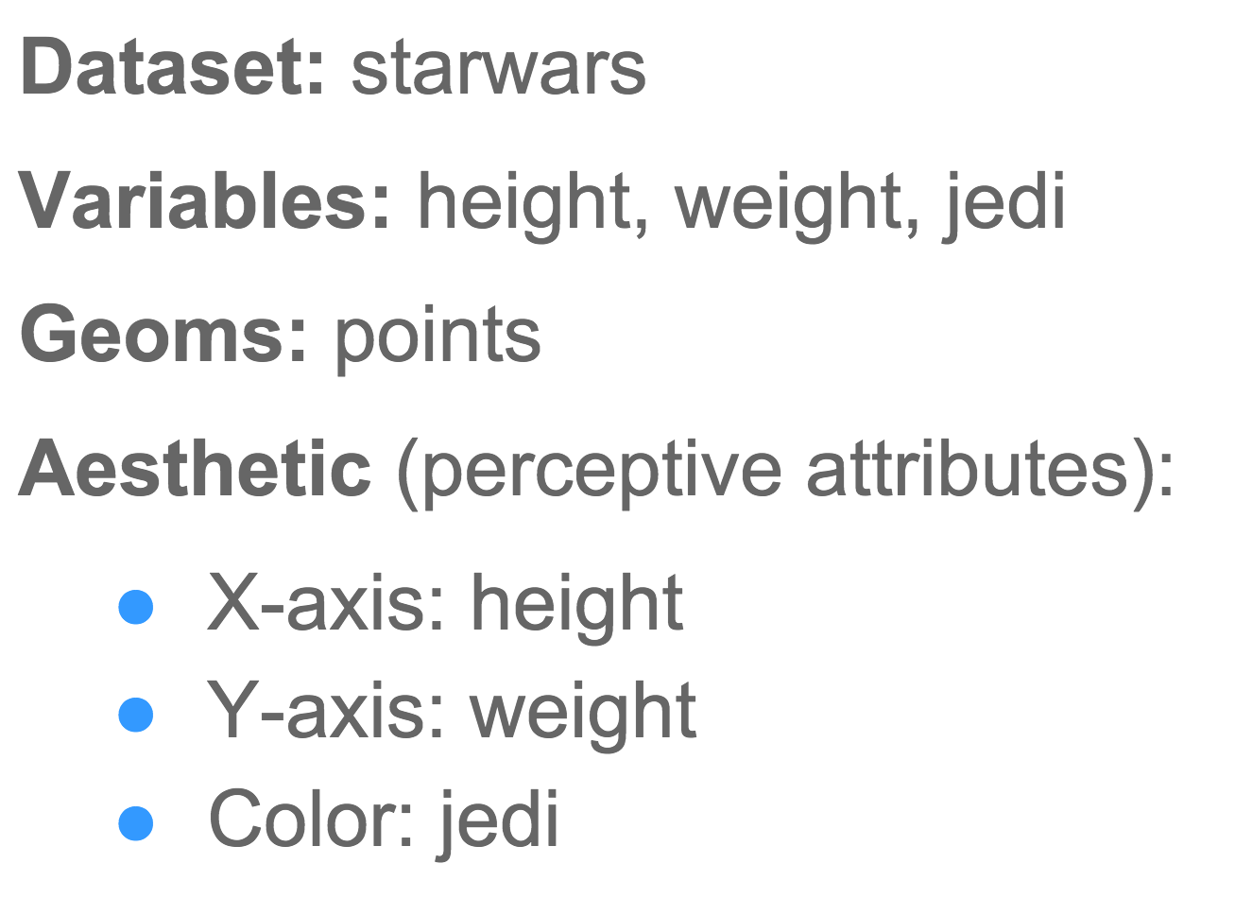
Visualizing Data
ggplot2 syntax: mapping data to geometric objects and aesthetic attributes
ggplot(data = starwars) +
geom_point(aes(x = height, y = weight, color = jedi))

Slide 27
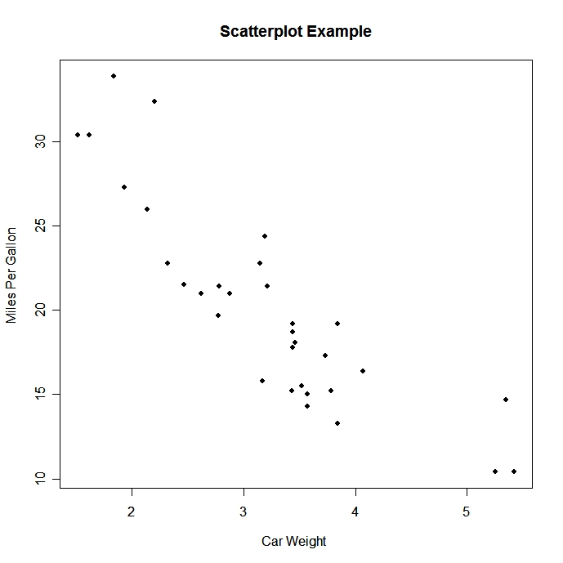
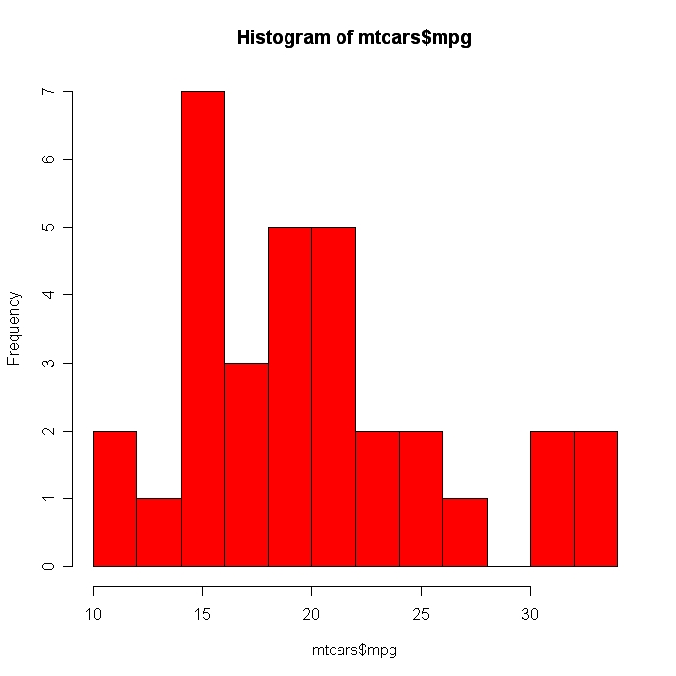
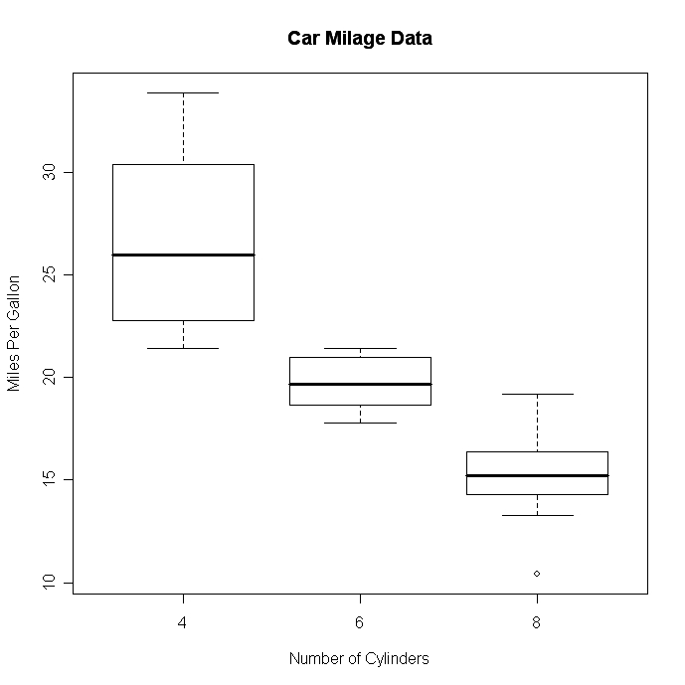
Visualizing Data
nonetheless, there are many base R functions that are well-suited for quick exploratory analyses of data:
plot(wt, mpg, main="Scatterplot Example",
xlab="Car Weight ", ylab="Miles Per Gallon ", pch=19)
hist(mtcars$mpg, breaks = 12, col = ‘red’)
boxplot(mpg~cyl,data=mtcars, main="Car Mileage Data",
xlab="Number of Cylinders", ylab="Miles Per Gallon")
Notes:
pairs() may work better than plot() when there are lots of variables

Slide 28
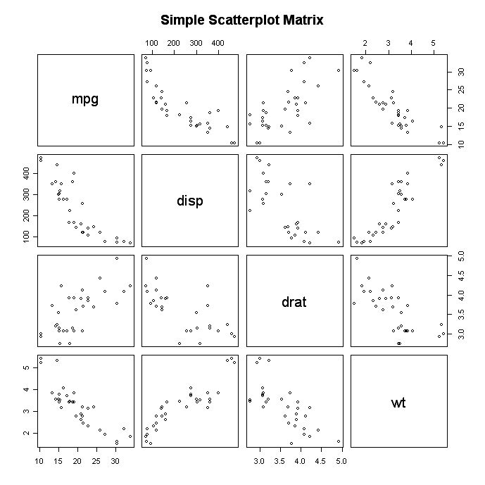
Visualizing Data
nonetheless, there are many base R functions that are well-suited for quick exploratory analyses of data:
pairs(~mpg+disp+drat+wt,data=mtcars,
main="Simple Scatterplot Matrix")
Notes:
pairs() may work better than plot() when there are lots of variables

Slide 29
Overview & Setup
Data Types & Data Structures
Tools for Data Wrangling & Exploratory Data Analysis
Conducting Statistical Tests
Discussion, Feedback, & Further Resources

Slide 30
Conducting Statistical Tests
A statistical test, or hypothesis test, provides a mechanism for making quantitative decisions about a process. The intent is to determine whether there is enough evidence to "reject" a hypothesis, or theory, about the process. We call this the null hypothesis.
Steps:
Understand the study / experiment, and determine which hypothesis test to use
State the null hypothesis and alternative hypothesis
Determine / calculate parameters appropriate for the test
Calculate the test statistic
Find the critical value from the appropriate distribution table
Compare the test statistic and the critical value ; this will result in our conclusion on whether we reject or fail to reject the null hypothesis
Notes:
Not rejecting the null hypothesis means that we “believe” the null hypothesis is true; i.e. there is not enough data to prove something by rejecting the null hypothesis.
Don’t accept the alternative hypothesis. Failing to reject the null hypothesis does NOT mean the null (H0) is true:
• Failing to reject the null means there is not enough evidence in your sample to reject the null hypothesis reject the null hypothesis.

Slide 31
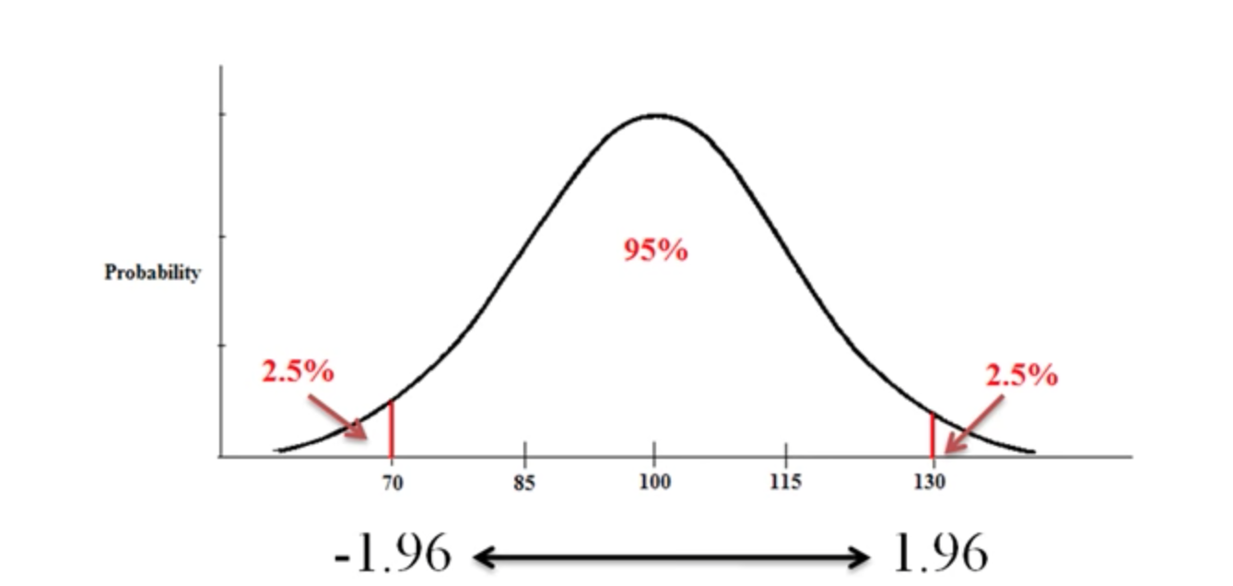
Conducting Statistical Tests
There are four common statistical tests that can be easily implemented in R :
Z-test
T-test
ANOVA
Chi-Square
REJECT
REJECT
α =
=α
Notes:
alpha level of significance is the probability of rejecting the null hypothesis given that it is true (type I error). For this tutorial, we will assume α =0.05, as that is most often used.
It is important to note that we want to set α before the experiment (a-priori) because the Type I error is the more ‘grevious’ error to make. The typical value of α is 0.05, establishing a 95% confidence level. For this tutorial, we will assume α =0.05. This helps us to determine our rejection regions (as a part of the Decision Rule Step of Analysis) for when we calculate our p-value / determine our p-value).
P-value comparing to alpha: “"If p is low, the null must go. If p is high, the null flies."
Resource that lists multiple tests and when they can/should be used: http://www.biostathandbook.com/testchoice.html

Slide 32
Z-test
Parametric test (assumes a normal distribution)
Sample size is large (n > 30), population standard deviation may or may not be known
Asks what is the probability of getting a certain sample mean
The z-test uses z-scores and a normal distribution to determine the probability that the sample mean is drawn randomly from a known population
Hypotheses -
Null: There is no statistically significant difference between the sample mean and the population mean.
Alternative: There is a statistically significant difference between the sample mean and the population mean.
Notes:
Parametric tests assumptions are based on distributions.
Tests continuous outcome.
Because of the central limit theorem, many test statistics are approximately normally distributed for large samples.
Also bc of central limit theorem we’re able to use SE instead of population standard deviation (also, if sigma / population sd is unknown, you can use s (sample sd) only if n>30).
P-value: (probability value) probability that the pattern of data in the sample could be produced by random data (so if we did this 100 times, 95% of the time we would reject the null hypothesis and 5% of the time we would not). P-value is the probability of observing a sample statistic as extreme as the test statistic.
Reject null if z-score is greater than critical value or less than -(critical value) ; Also, when calculated p-value (1-critical value for a one tail test for example) is smaller than 0.05. Thus, the sample is likely to be a result of non-random sampling.
Do NOT reject the null if z-score falls in the range between -critical value and +critical value ; Also, when p-value is greater than 0.05. Thus , random sampling is likely to have produced this.
Statistically Significant: instructs us to reject the null hypothesis because the pattern in the data differs from what we would expect by chance alone.
By increasing sample size, one can increase the value of the test statistic, thus increasing probability of finding a significant effect.

Slide 33
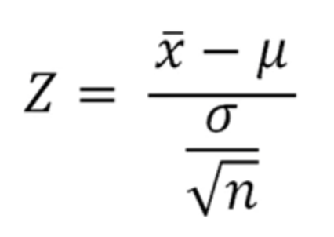
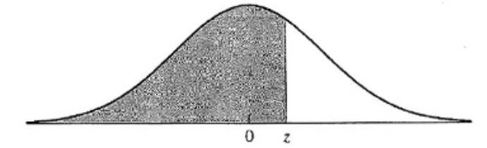
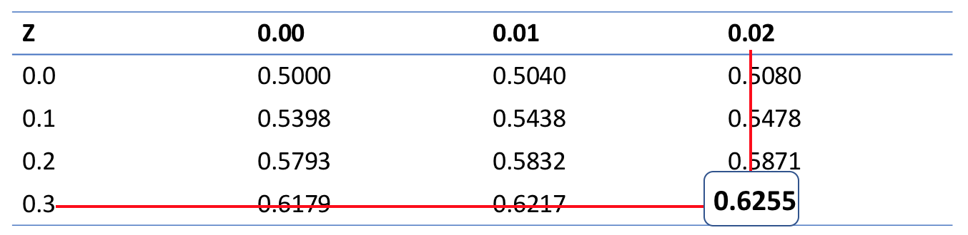
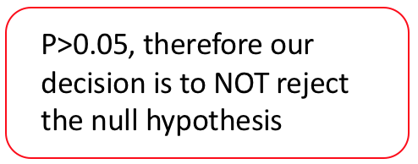
Z-test
Our z test statistic is 0.32
According to the table, P(z<0.32) = 0.6255
Therefore, P(z>=0.32)
= 1 - 0.6255 = 0.3725
Notes:
Mu: population mean
SE: is standard error / replacement for population standard deviation (which is deviation from the mean)
xbar: is the sample mean
n :sample size
Critical value: our cutoff value for determining the region where we reject / do not reject the null hypothesis
We are discussing an example that is a one-sided z-test, but you can tell by how your hypotheses are stated which to use. If mu1=mu2 then its a 2-sided test. If mu1>mu2 or mu1<mu2, then it’s a 1-sided test.

Slide 34
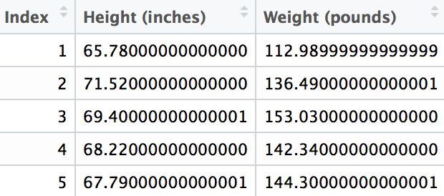
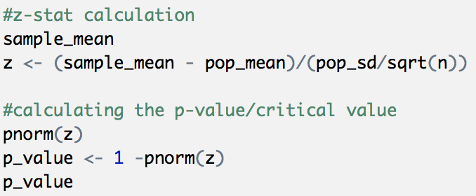
Z-test Example
Null Hypothesis: There is no statistically significant difference between the sample mean and the population mean.
Alternative Hypothesis: There is a statistically significant difference between the sample mean and the population mean (sample mean is greater than the population mean).
Problem Statement:
Data represents the heights of 100 children from Hong Kong. We sample 50 from the population of their height (in inches) and weight (in pounds). We want to know if the sample of the children's heights are significantly different from the height of the population.

Slide 35
T-test
Parametric test (assumes a normal distribution)
Sample size is small (n < 30), population standard deviation is not known
Asks what is the probability of getting a certain sample mean?
Compares the means of a variable from two groups
one sample t-test: compares the means of two different groups (e.g., reaction times on a task for women vs. men)
Null: There is no statistically significant difference between the sample mean and the population mean.
Alternate: There is a significant difference between the sample mean and the population mean.
two sample t-test: compares the means of the same group at two different times (e.g., reaction times for the same people on a task before or after a training period)
Null: There is no statistically significant difference between the means of the two variables/samples.
Alternate: There is a significant difference between the means of the two variables/samples.
paired t-test: similar to the two sample t-test, except that the independence assumption is not valid.
Notes:
One-Sample & Two-Sample T Tests:
Critical value from table (dof (2 sample) = n1 + n2 - 2) (dof (1 sample) = n-1)
If t-value is < critical value (do NOT reject the null)
If t-value is > critical value (reject the null) OR p-value is less than 0.05.
Paired t-test used to determine whether the mean difference between two sets of observations is zero. In a paired sample t-test, each subject or entity is measured twice, resulting in pairs of observations. Tends to be done in science work. Specifically, experimental settings where each subject in the study is in both the treatment and control group. For example, in a matched pairs design, subjects are matched in pairs and different treatments are given to each subject in the pair.
The whole idea behind the t-test is to compare the ratio of between group variance to within group variance. If the variance caused by the interaction between the samples is much larger when compared to the variance that appears within each group, then it is because the means aren't the same.
Variance between groups: variance that is due to the independent variable, the difference among the three groups. For example the difference between a person's score in group one and a person's score in group two would represent explained variance.
Variance within groups: refers to variations caused by differences within individual groups (or levels). variance that is not due to the independent variable. For example, the difference between one person in group one and another person in group one would represent error variance.

Slide 36
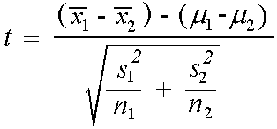
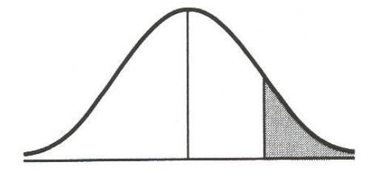
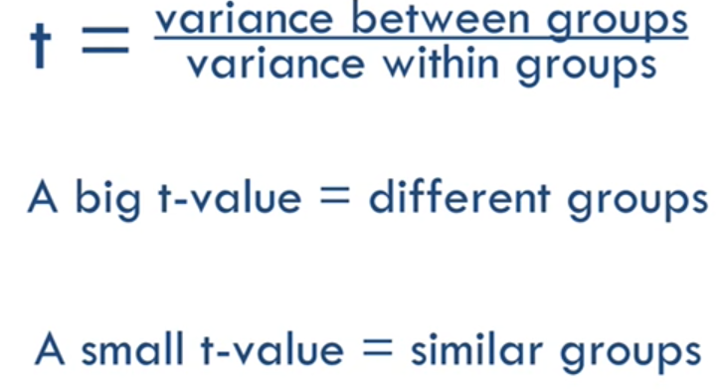
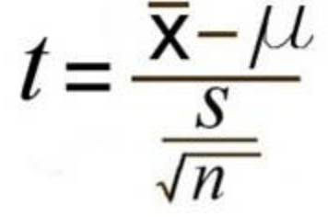
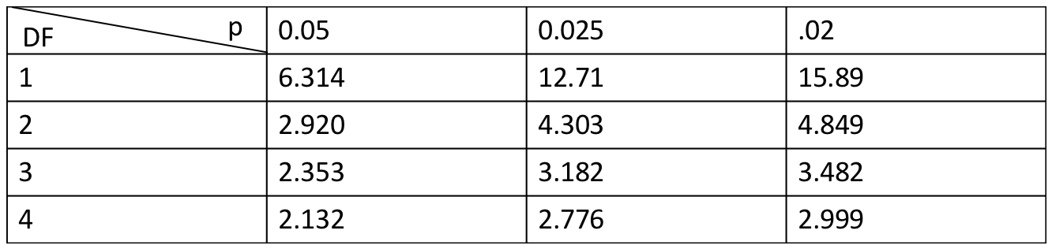
T-test
DF = n1 + n2 - 2
DF = n-1
p
t
Notes:
X is the sample mean
Mu is the population mean
n is the sample size
S is the sample standard deviation

Slide 37

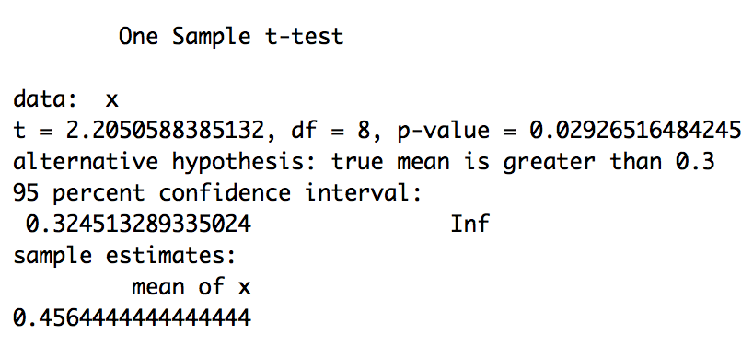
One-Sample T-test Example
Let be the mean level of Salmonella in all batches of ice cream.
Null Hypothesis: There is no statistically significant difference between the sample mean and the population mean ( = 0.3)
Alternative Hypothesis: There is a statistically significant difference between the sample mean and the population mean ( > 0.3)
Problem Statement:
An outbreak of Salmonella-related illness was attributed to ice cream produced at a certain factory. Scientists measured the level of Salmonella in 9 randomly sampled batches of ice cream. The levels (in MPN/g) were:
0.593 0.142 0.329 0.691 0.231 0.793 0.519 0.392 0.418
Is there evidence that the mean level of Salmonella in the ice cream is greater than 0.3 MPN/g?
One-Sample
Notes:
p-value is 0.02927 which is less than 0.05, leading us to conclude that there is moderately strong evidence for us to reject the null hypothesis & conclude that the mean level of Salmonella in the ice cream is greater than 0.3 MPN/g.
(Source: http://www.stat.columbia.edu/~martin/W2024/R2.pdf)

Slide 38
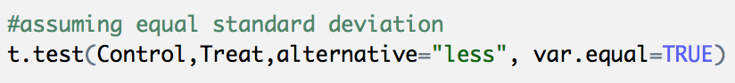
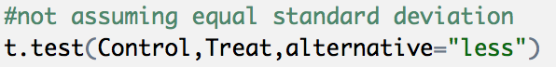
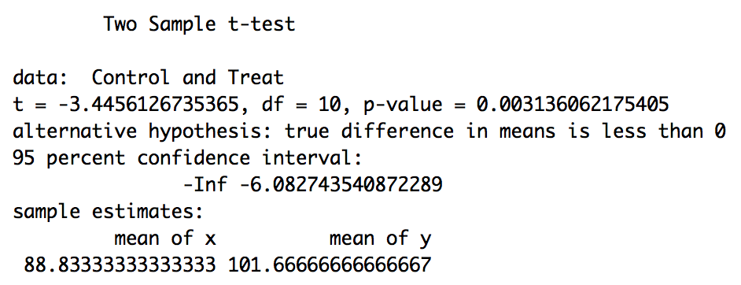

Two-Sample T-test Example
Let mu1 be the mean of the population taking medicine and mu2 the mean of the untreated population.
Null Hypothesis: there is no statistically significant difference between the group means (mu1-mu2=0)
Alternative Hypothesis: there is a statistically significant difference between the group means (mu1-mu2<0)
Problem Statement:
6 subjects were given a drug (treatment group) and an additional 6 subjects a placebo (control group). Their reaction time to a stimulus was measured (in ms). We want to perform a two-sample t-test for comparing the means of the treatment and control groups.
Two-Sample
Notes:
Results:
For the t test assuming equal sd, the pvalue is 0.003136 leading us to reject the null hypothesis.
For the t test not assuming equal sd, the pvalue is 0.003391 leading us to reject the null hypothesis.
Thus, we conclude with fairly high certainty that there is a statistical difference between the Control and Treatment means/averages.
(Source: http://www.stat.columbia.edu/~martin/W2024/R2.pdf)

Slide 39

Paired T-test Example
Let mu1 be the mean of the population of cars using premium gas and mu2 the mean of the population of cars using regular gas.
Null Hypothesis: there is no statistically significant difference between the group means (mu1-mu2=0)
Alternative Hypothesis: there is a statistically significant difference between the group means (mu1-mu2>0)
Problem Statement:
A study was performed to test whether cars get better mileage on premium gas than on regular gas. Each of 10 cars was first filled with either regular or premium gas, decided by a coin toss, and the mileage for that tank was recorded. The mileage was recorded again for the same cars using the other kind of gasoline. We use a paired t-test to determine whether cars get significantly better mileage with premium gas.
Paired t-test
Notes:
Results:
pvalue is 0.0007749 and is less than 0.05, leading us to reject the null hypothesis and conclude that there is a statistically sgnificant difference between the group means. Thus, because we see from the t-test that there is strong evidence of a mean increase in gas mileage between regular and premium gasoline, we conclude that cars get significantly better mileage with premium gas.
(Source: http://www.stat.columbia.edu/~martin/W2024/R2.pdf)

Slide 40
ANOVA
ANalysis Of VAriance
Parametric test (normal distribution)
Asks whether the population means of several groups are equal (generalization of t-test for more than two groups)
One-Way:
Assumptions:
The dependent variable is normally distributed (as well as response variable residuals).
The two groups have approximately equal variance on the dependent variable.
Variables are independent and identically distributed (iid).
Hypotheses:
Null: There are no significant differences between the groups' / samples’ means (and thus all come from a larger overall population)
Alternate: There is a significant difference between the groups' / samples’ means.
Notes:
The whole idea behind the analysis of variance is to compare the ratio of between group variance to within group variance. If the variance caused by the interaction between the samples is much larger when compared to the variance that appears within each group, then it is because the means aren't the same.
Variance between groups: variance that is due to the independent variable, the difference among the three groups. For example the difference between a person's score in group one and a person's score in group two would represent explained variance.
Variance within groups: refers to variations caused by differences within individual groups (or levels). variance that is not due to the independent variable. For example, the difference between one person in group one and another person in group one would represent error variance.
Two-Way:
Assumptions:
The standard deviations (SD) of the populations for all groups are equal - this is sometimes referred to as an assumption of the homogeneity of variance.
The samples are randomly selected from the population
Hypotheses:
Null: there is no interaction between columns (data sets) and rows. Any systematic differences between columns are the same for each row and that any systematic differences between rows are the same for each column.
Alternate: there is interaction between columns and rows.

Slide 41





ANOVA
Variance Between + Variance Within = Total Variance
Variance Between
Total Variance Components
Variance Within
Notes:
The whole idea behind the analysis of variance is to compare the ratio of between group variance to within group variance. If the variance caused by the interaction between the samples is much larger when compared to the variance that appears within each group, then it is because the means aren't the same.
Treatment is same as between group ("explained variance" or "systematic variance". We can think of this as variance that is due to the independent variable (factor), the difference among the three groups. For example the difference between a person's score in group one and a person's score in group two would represent explained variance. )
Error is same as within group ("error variance". This is the variance within your groups, variance that is not due to the independent variable. For example, the difference between one person in group one and another person in group one would represent error variance.)
DFE is dof for within variance = N-k (total number of observations - number of comparison groups)
DFT is dof for between variance = k-1 (number of comparison groups -1)
MSB/MSE is mean squares
SST/SSE is sum of squares
F = MSB/MSE
Total = Between + Within
Reject null if F-score is > critical value
Do NOT reject null if F-score is < critical value
Interpreting F-score:
When the null hypothesis of equal means is true, the two mean squares estimate the same quantity (error variance), and should be of approximately equal magnitude. In other words, their ratio should be close to 1. If the null hypothesis is false, MSB should be larger than MSE.

Slide 42




ANOVA Example
Problem Statement:
A drug company tested three formulations of a pain relief medicine for migraine headache sufferers. For the experiment 27 volunteers were selected and 9 were randomly assigned to one of three drug formulations. The subjects were instructed to take the drug during their next migraine headache episode and to report their pain on a scale of 1 to 10 (10 being most pain).
Null Hypothesis: there are no significant differences between the drug groups' means
Alternative Hypothesis: there is a significant difference between the drug group's means
DrugA 4 5 4 3 2 4 3 4 4 | DrugB 6 8 4 5 4 6 5 8 6 | DrugC 6 7 6 6 7 5 6 5 5
Notes:
Results:
p-value is 0.000256 which is a lot smaller than 0.05, thus we have strong evidence to reject the null hypothesis meaning all three drug groups do not have equal means / there is a difference between their means. Due to significant results, we move on to the second step of analysis -- a post hoc test.
The second step of our analysis asks how the drug groups differ. To answer this, we use a pairwise t-test that accounts for multiple groups as well as a Tukey Honest Significant Difference test.
Pairwise t test results show that the difference in means is not significantly different between drugs B and C (pvalue=1), but both are significantly different from drug A (pvalue=0.00119 and pvalue=0.00068). Thus, we can conclude that the mean pain is significantly different for drug A.
Tukey results that the B-A and C-A differences are significant (p=0.0011 and p=0.00065, respectively), while the C-B difference is not (p=0.97). This confirms the results obtained using Bonferroni correction.
(Source: http://www.stat.columbia.edu/~martin/W2024/R3.pdf)

Slide 43
Chi-Square Test
Nonparametric test (does not assume known distribution)
Used for nominal data (such as wanting to see if there is a difference based on gender to your project question)
Used to find out how the observed value of a given phenomena is significantly different from the expected value
Goodness-of-Fit: Determines if the observed frequencies are different from what we would expect to find (often times using population data or theoretical data). Used to compare the observed sample distribution with the expected probability distribution.
Assumptions:
The population is at least 10 times as large as the sample.
The expected value for each level of the variable is at least 5.
Sampling method is simple random sampling (SRS).
Hypotheses:
Null: there is no significant difference between the observed and the expected value (expected distribution is correct).
Alternate: there is a significant difference between the observed and the expected value (expected distribution is not correct).
Notes:
Nonparametric test: Non-parametric tests still have assumptions but not based on assumptions, but not based on distributions.
Degree of freedom:
DF = k - 1 (k is number of levels)
Expected Frequency Count:
Ei = npi (sample size times the hypothesized proportion from the null hypothesis) (Ei is the expected frequency count for the ith level of the categorical variable, n is the total sample size, and pi is the hypothesized proportion of observations in level i)
Test of Independence: Determine the association between 2 categorical variables.
Assumptions:
None of the expected values may be less than 1
No more than 20% of the expected values may be less than 5
Hypotheses:
Null: There is no association between the two variables.
Alternate: There is an association between the two variables.

Slide 44



Chi-Square Test
Notes:
O: observed value
E: expected value
Expected Frequency Count:
Ei = npi (sample size times the hypothesized proportion from the null hypothesis) (Ei is the expected frequency count for the ith level of the categorical variable, n is the total sample size, and pi is the hypothesized proportion of observations in level i)
Degree of freedom:
DF = k - 1 (k is number of levels)
If the calculated value of Chi-Square goodness of fit test is greater than the table value, we will reject the null hypothesis (p-value less than 5%).
If the calculated value of Chi-Square goodness of fit test is less than the table value, we will fail to reject the null hypothesis (p-value greater than 5%).

Slide 45



Chi-Square Test Example
Problem Statement:
We collected wild tulips and found that 81 were red, 50 were yellow, and 27 were white. Are these colors equally common? We want to know if there is any significant difference between the observed proportions and the expected proportions.
Null hypothesis: There is no significant difference between the observed and the expected value.
Alternative hypothesis: There is a significant difference between the observed and the expected value.
res1
res2
Notes:
Results:
p-value is 8.803^(-07) which is smaller than 0.05, thus we reject the null hypothesis and conclude that the colors are not equally common / not commonly distributed. Additionally, from the second chi-sq test we get that the p-value is p-value = 0.9037, which is greater than 0.05. Thus, we conclude that there is no significant difference between the observed and expected values.
(Source: http://www.sthda.com/english/wiki/chi-square-goodness-of-fit-test-in-r)

Slide 46






Simple Linear Regression
Explores and models the relationship between two or more variables
We can carry out the previously mentioned hypotheses test on the coefficients of a simple linear regression
Assumptions:
Random errors are
normally distributed (Parametric)
Independently and identically distributed (iid)
Hypotheses:
T-test
Null: the true slope equals some constant value( )
Alternative: the true slope does not equal some constant value ( )
ANOVA
Null: regression model is not statistically significant (a regression model cannot be applied to the observed data) ( )
Alternative: regression model is statistically significant (a regression model can be applied to the observed data) ( )

Slide 47


Simple Linear Regression
Null Hypothesis: There is no significant relationship between the variables (β = 0)
Alternative Hypothesis: There is a significant relationship between the variables (β != 0)
Problem Statement:
Decide whether there is a significant relationship between the variables, distance and speed, in the linear regression model of the data set "cars" at 0.05 significance level.

Slide 48
Overview & Setup
Data Types & Data Structures
Data Wrangling & Exploratory Data Analysis
Conducting Statistical Tests
Discussion, Feedback, & Further Resources

Slide 49
Questions, Comments, & Feedback

Slide 50
Further Resources
R学习路线 - https://blog.csdn.net/BETTINA26/article/details/52956391
时间序列分析及应用: R语言 http://bbs.pinggu.org/a-1423839.html
R technical manuals: https://cran.r-project.org/manuals.html
R contributed documentation (some written in Chinese): https://cran.r-project.org/other-docs.html
R导论 (An introduction to R): https://cran.r-project.org/doc/contrib/Ding-R-intro_cn.pdf
153分钟学会R: https://cran.r-project.org/doc/contrib/Liu-FAQ.pdf
CRAN task views: https://cran.r-project.org/web/views
The R Journal: https://journal.r-project.org
R-related posts in StackOverflow (forum for asking programming questions): http://stackoverflow.com/questions/tagged/r
R Bloggers: https://www.r-bloggers.com

Slide 51
Acknowledgements
Thanks for listening, and welcome to R!
Some of our presentation content was adopted from instructional material developed for UC Berkeley’s Statistics 133 course (“Concepts in Computing with Data”) by Prof. Gaston Sanchez.
For direct access to course materials and more tutorials, please visit https://github.com/ucb-stat133/stat133-fall-2017/.

